Slide 1
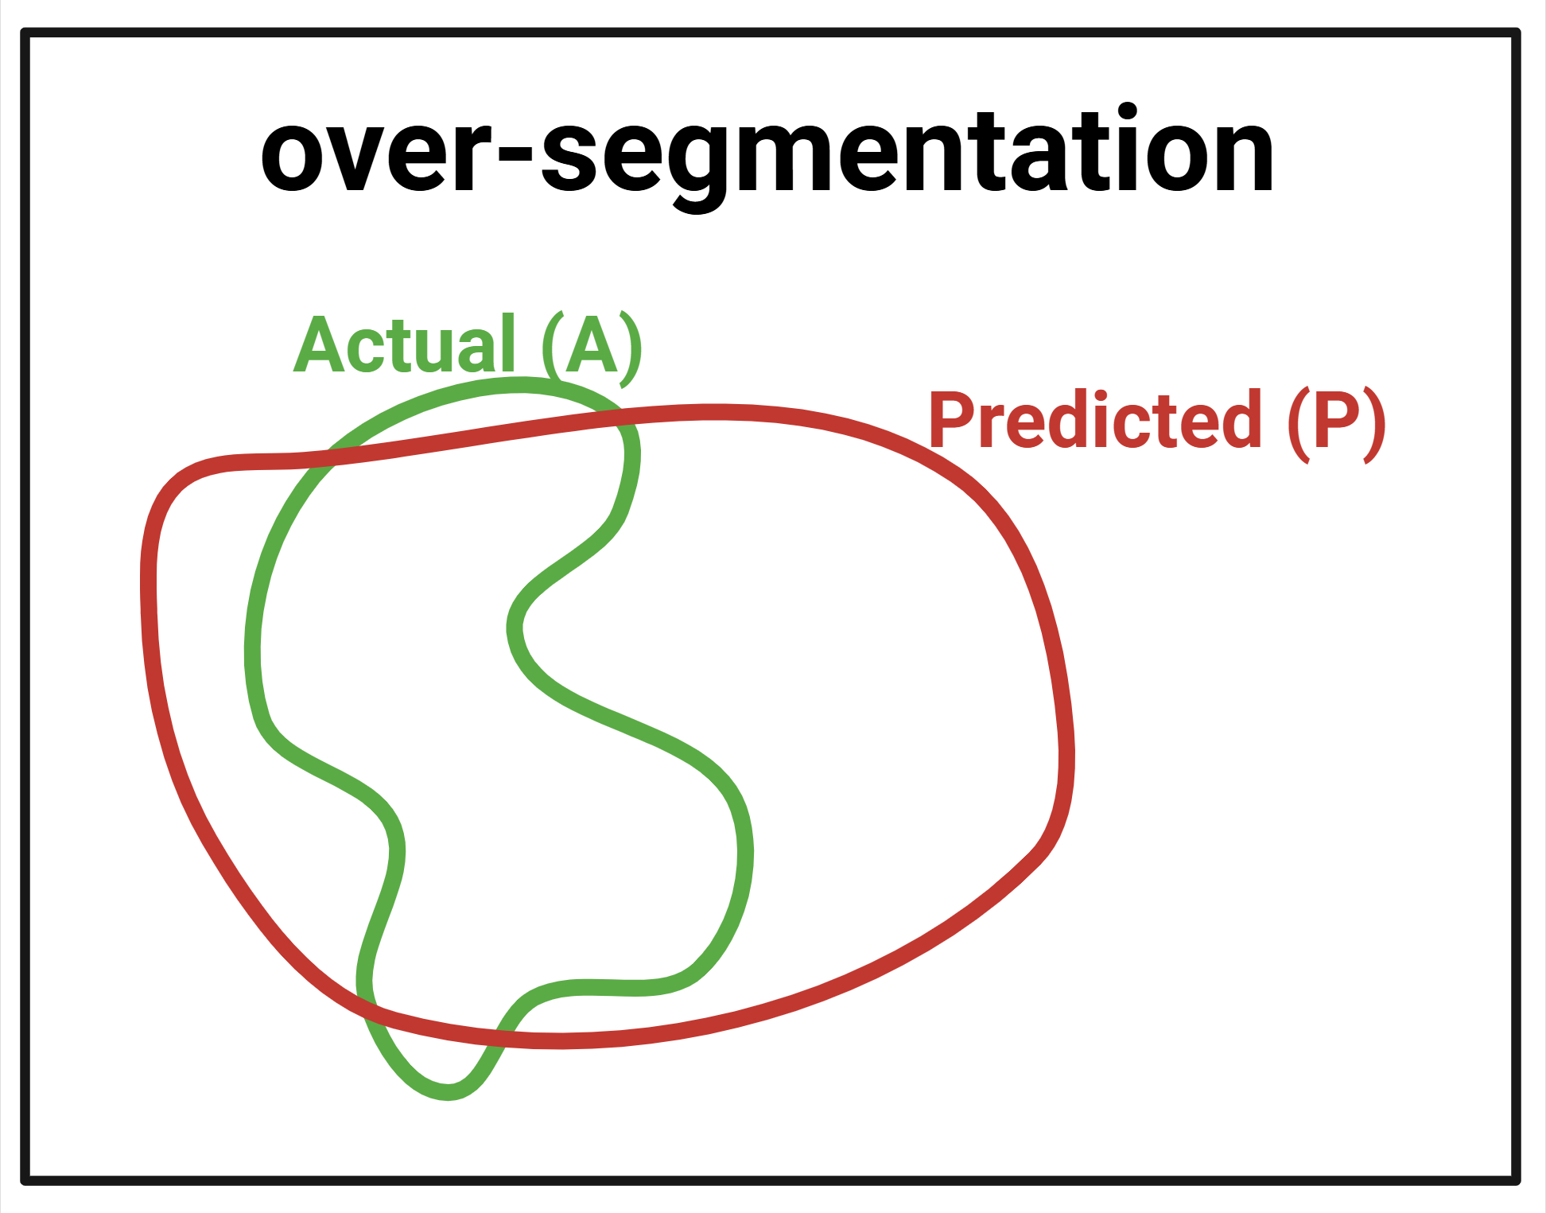
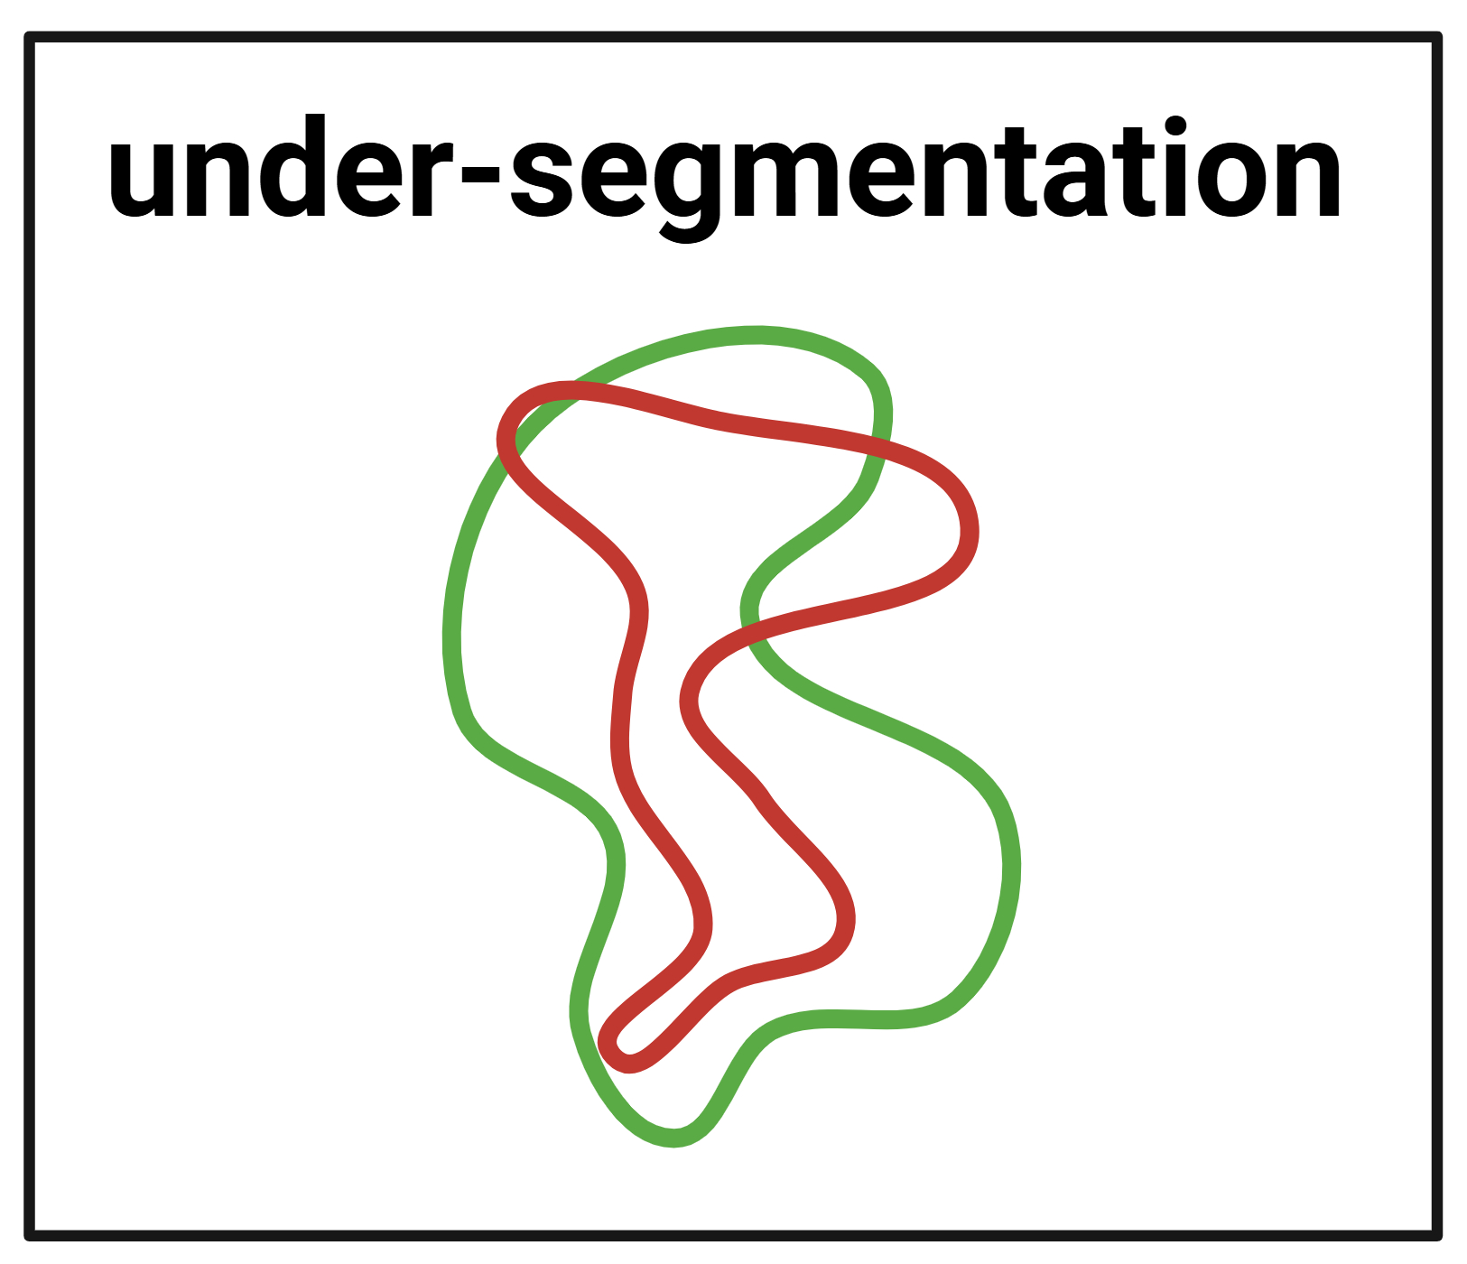
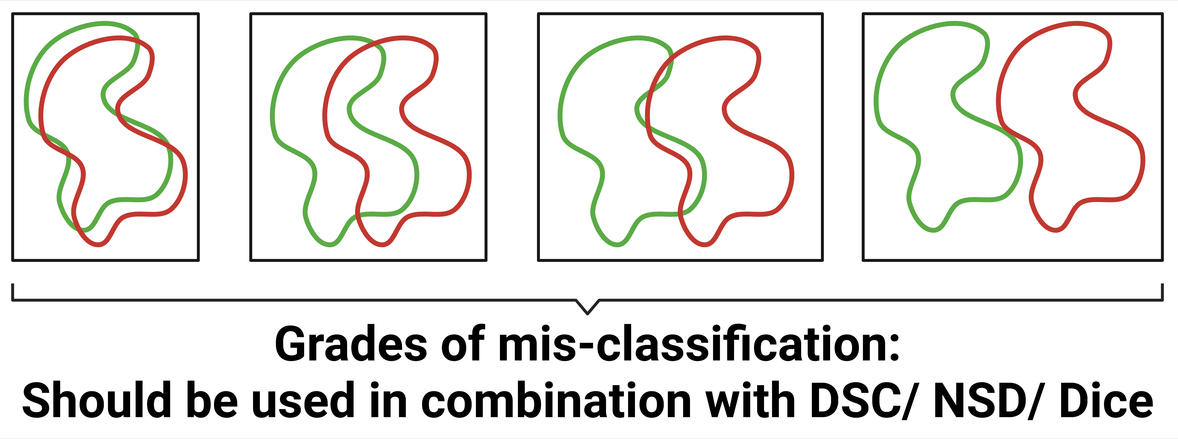
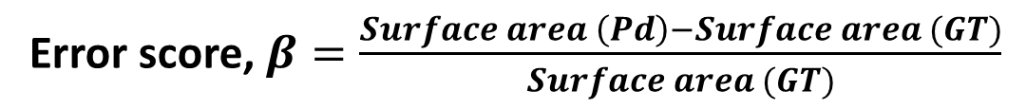
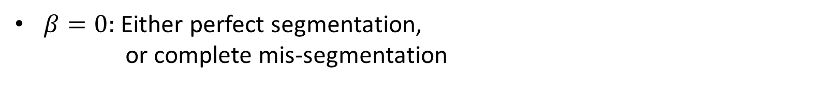
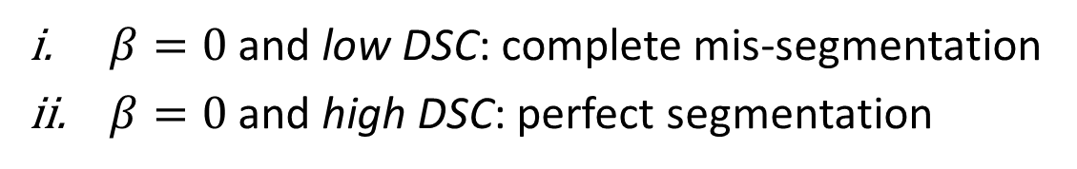
Error characterization protocol
The analysis framework – Q1
Q1: Ranking organs as per susceptibility to being under- or over-segmented (2)
Error score, $β=\frac{Surface area \left(Pd\right)−Surface area (GT)}{Surface area (GT)}$
$β>0:$ over-segmentation
$β<0:$ under-segmentation
$β=0:$ Either perfect segmentation,
or complete mis-segmentation
$β=0$ and low DSC: complete mis-segmentation
$β=0$ and high DSC: perfect segmentation
Therefore, setting an upper and lower bound (thresholds) on $β$ and DSC solve the problem.

Slide 2
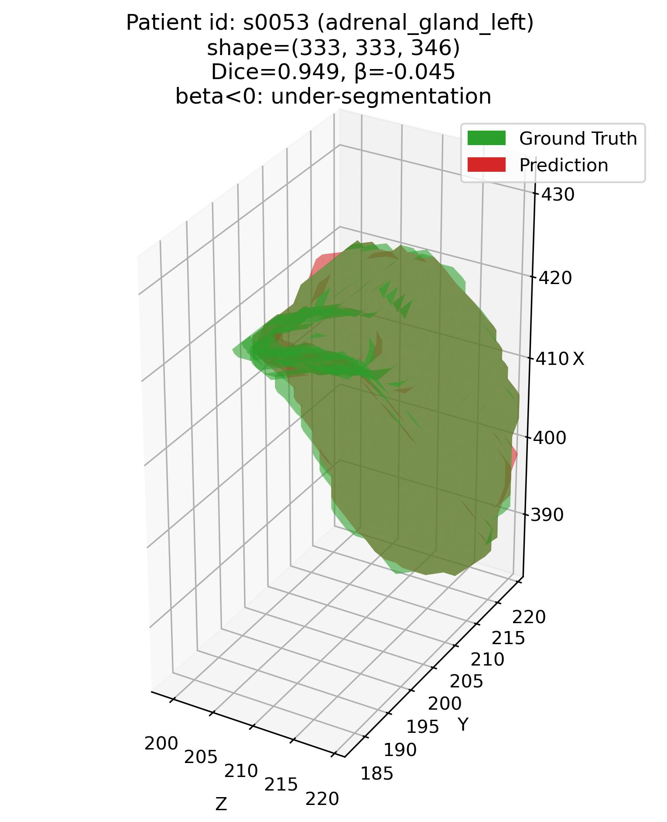
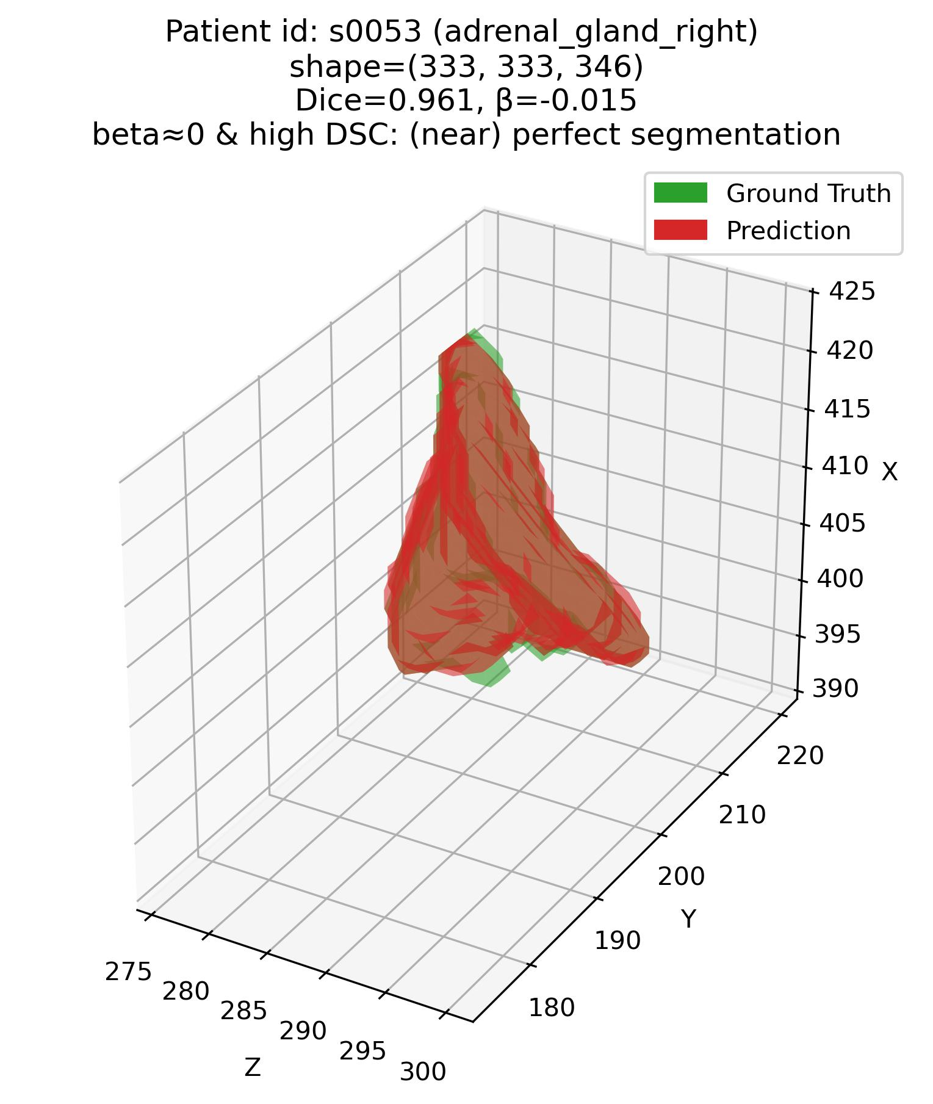
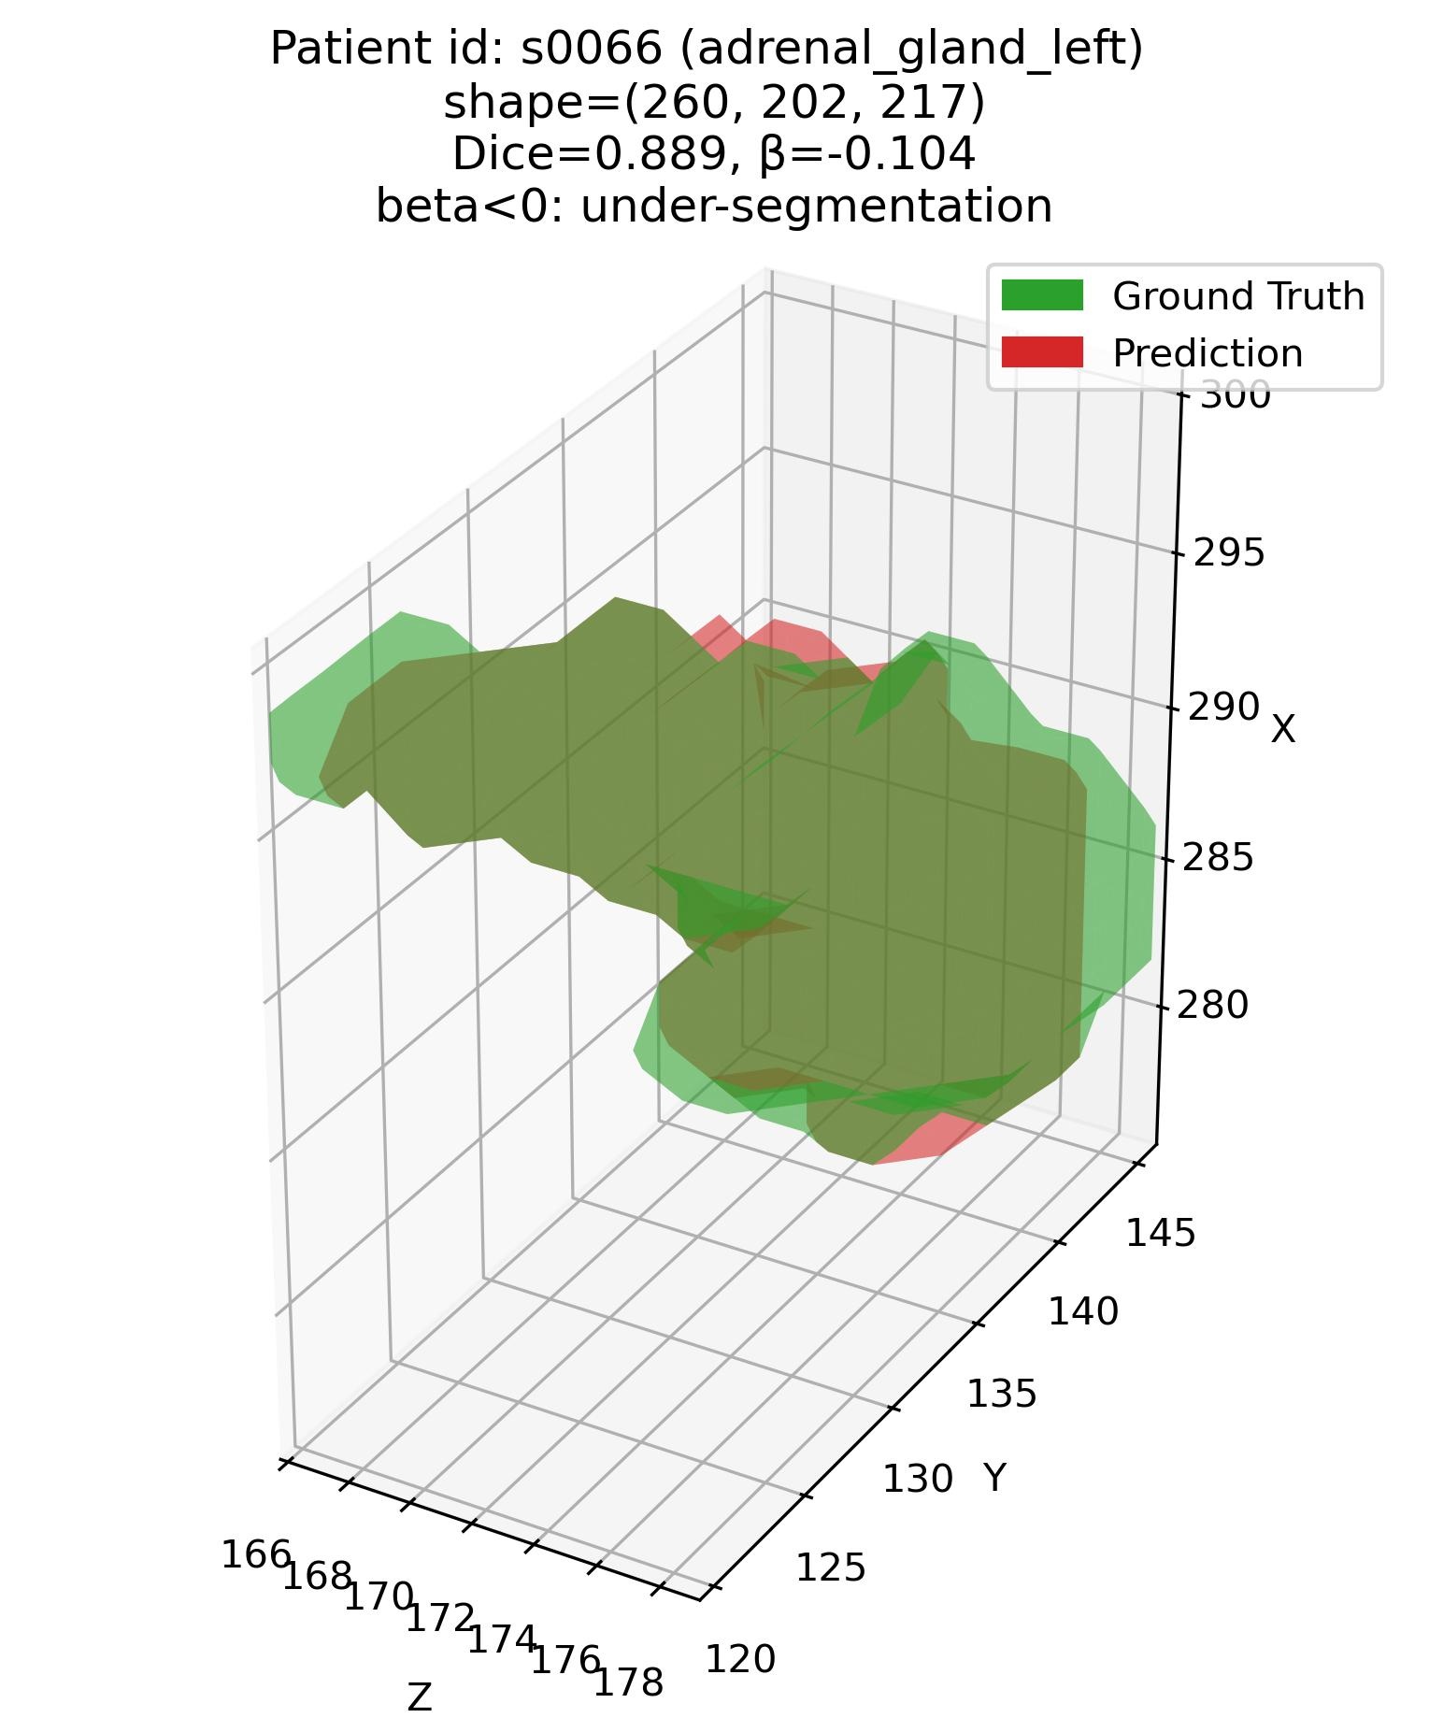
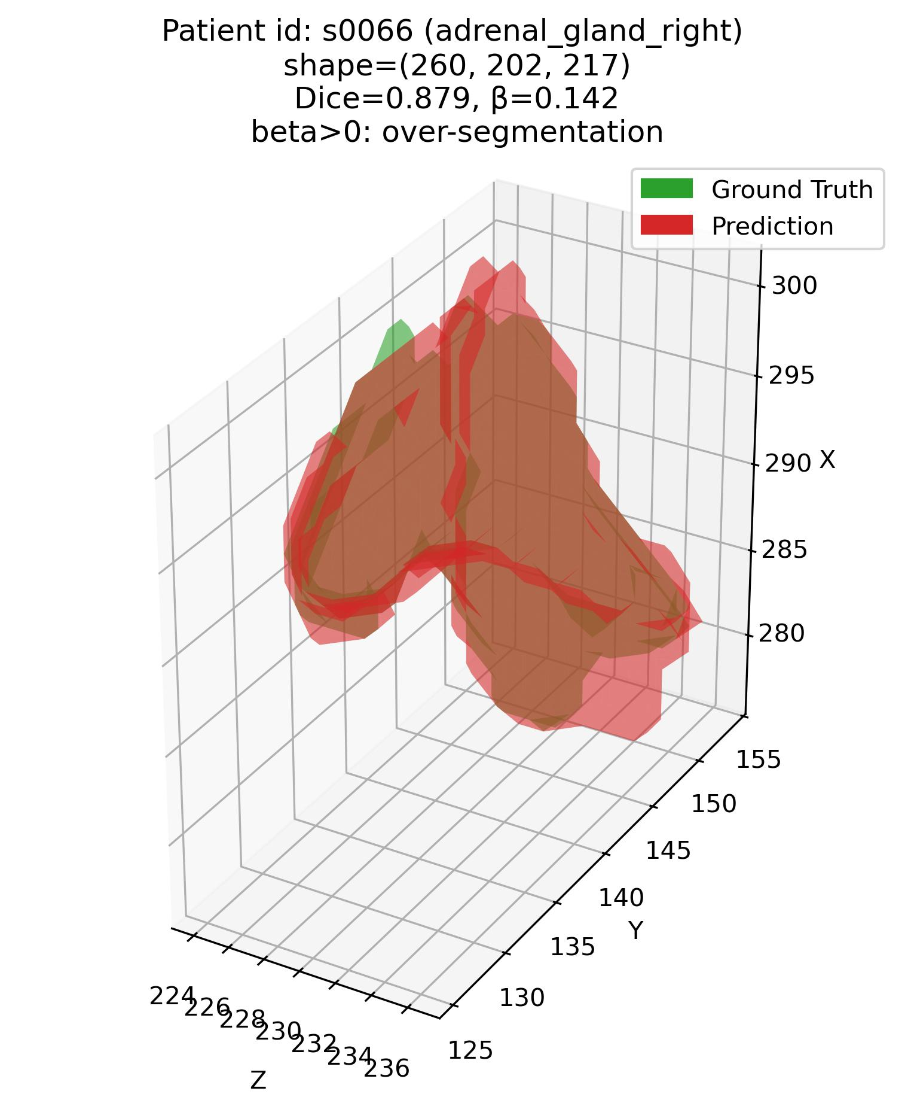
Error characterization protocol
The analysis framework – Q1
Q1: Some examples – 1. Adrenal glands
Patient# s0053 (adrenal glands)
Patient# s0066 (adrenal glands)

Slide 3
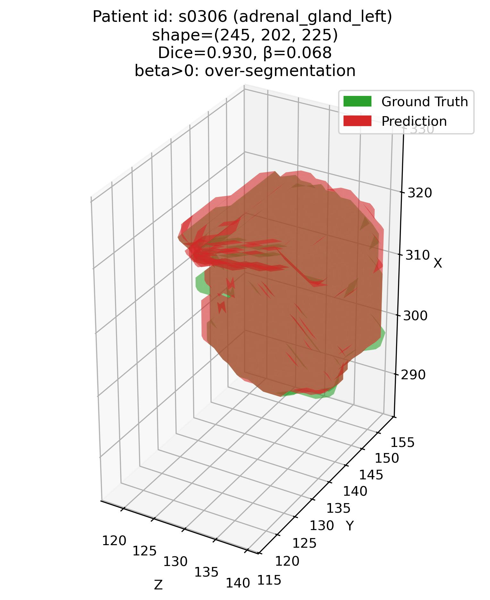
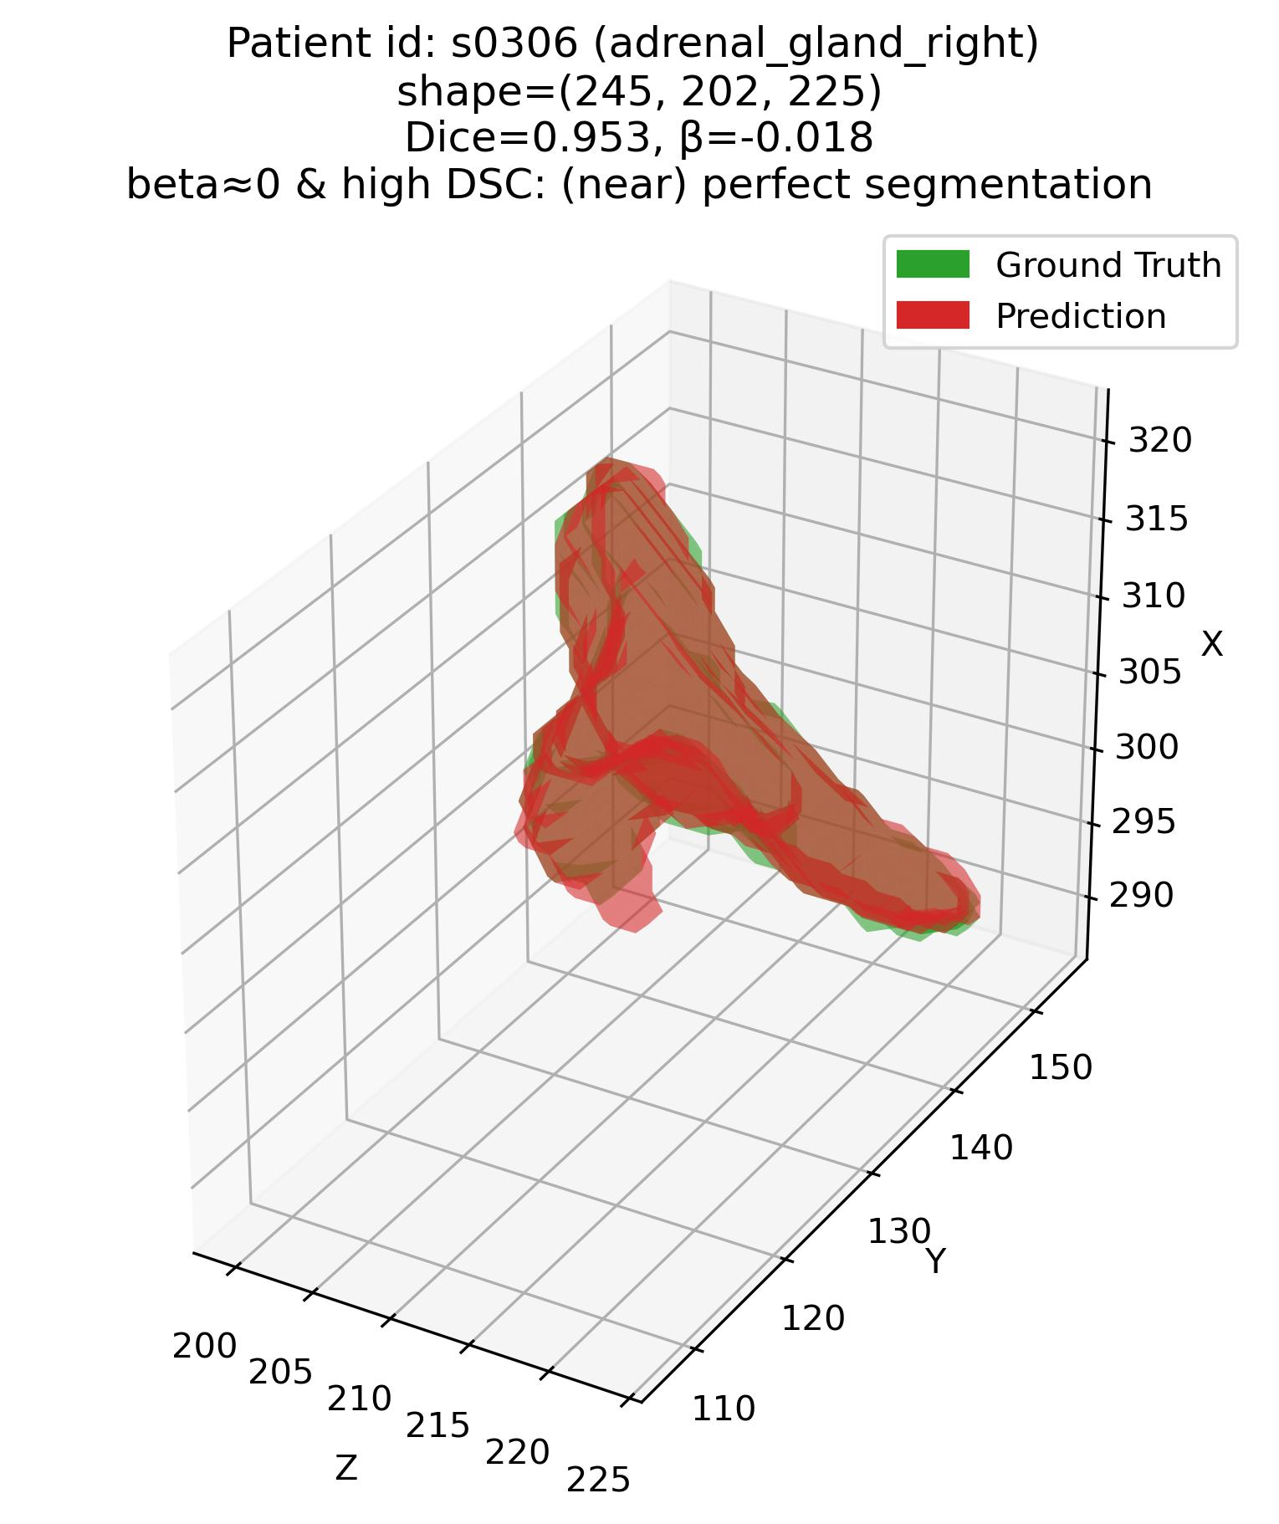
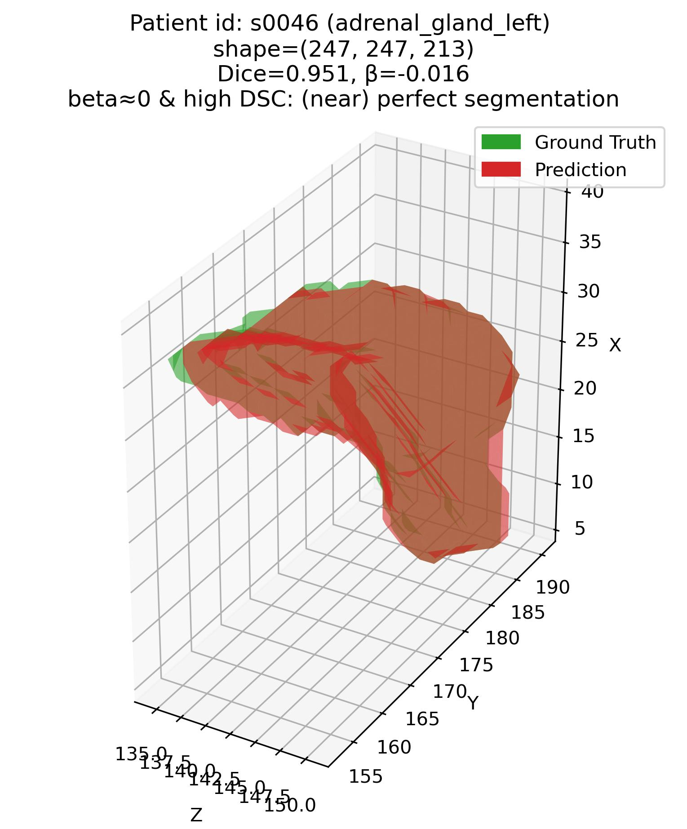
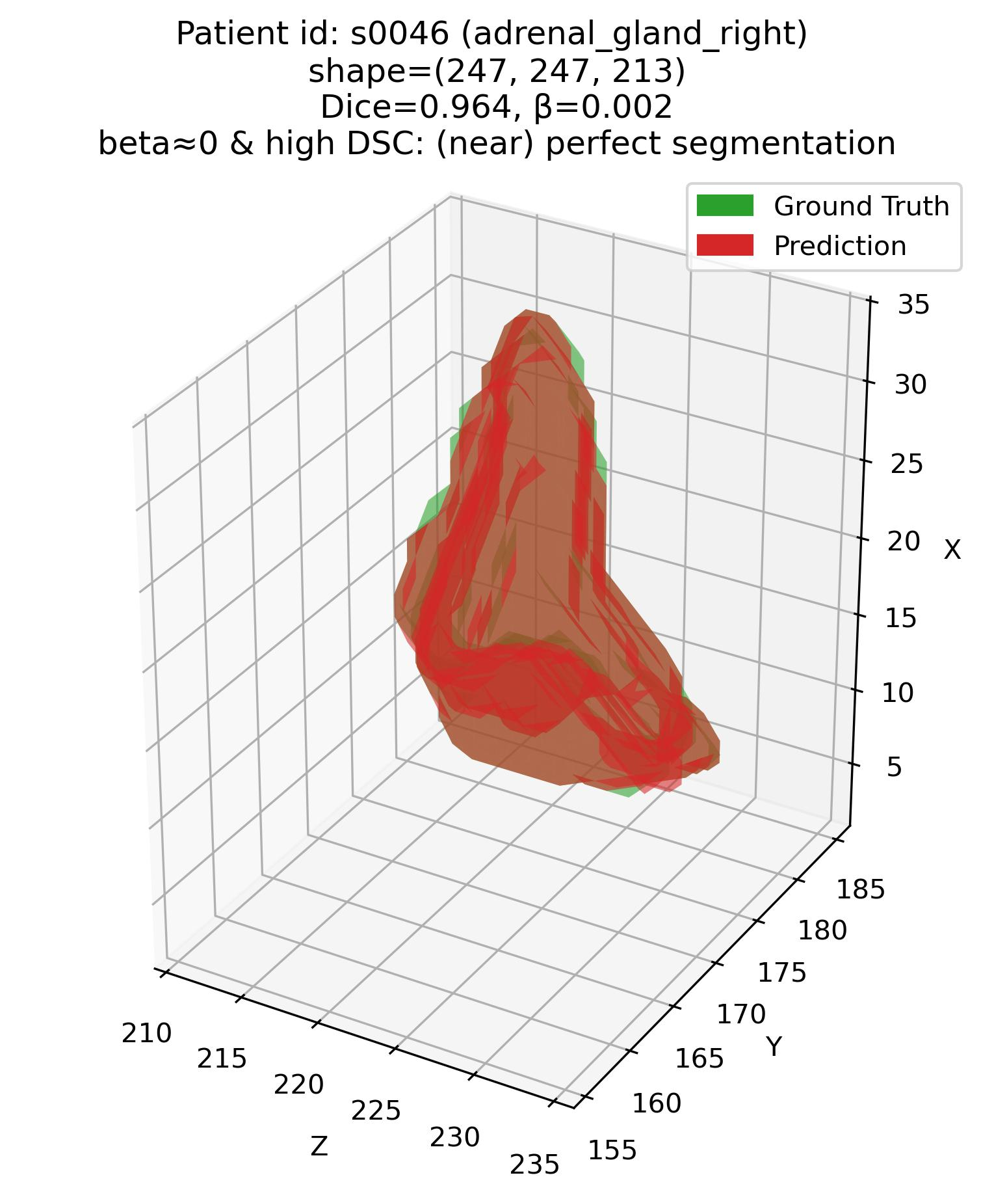
Error characterization protocol
The analysis framework – Q1
Q1: Some examples – 1. Adrenal glands
Patient# s0306 (adrenal glands)
Patient# s0046 (adrenal glands)

Slide 4
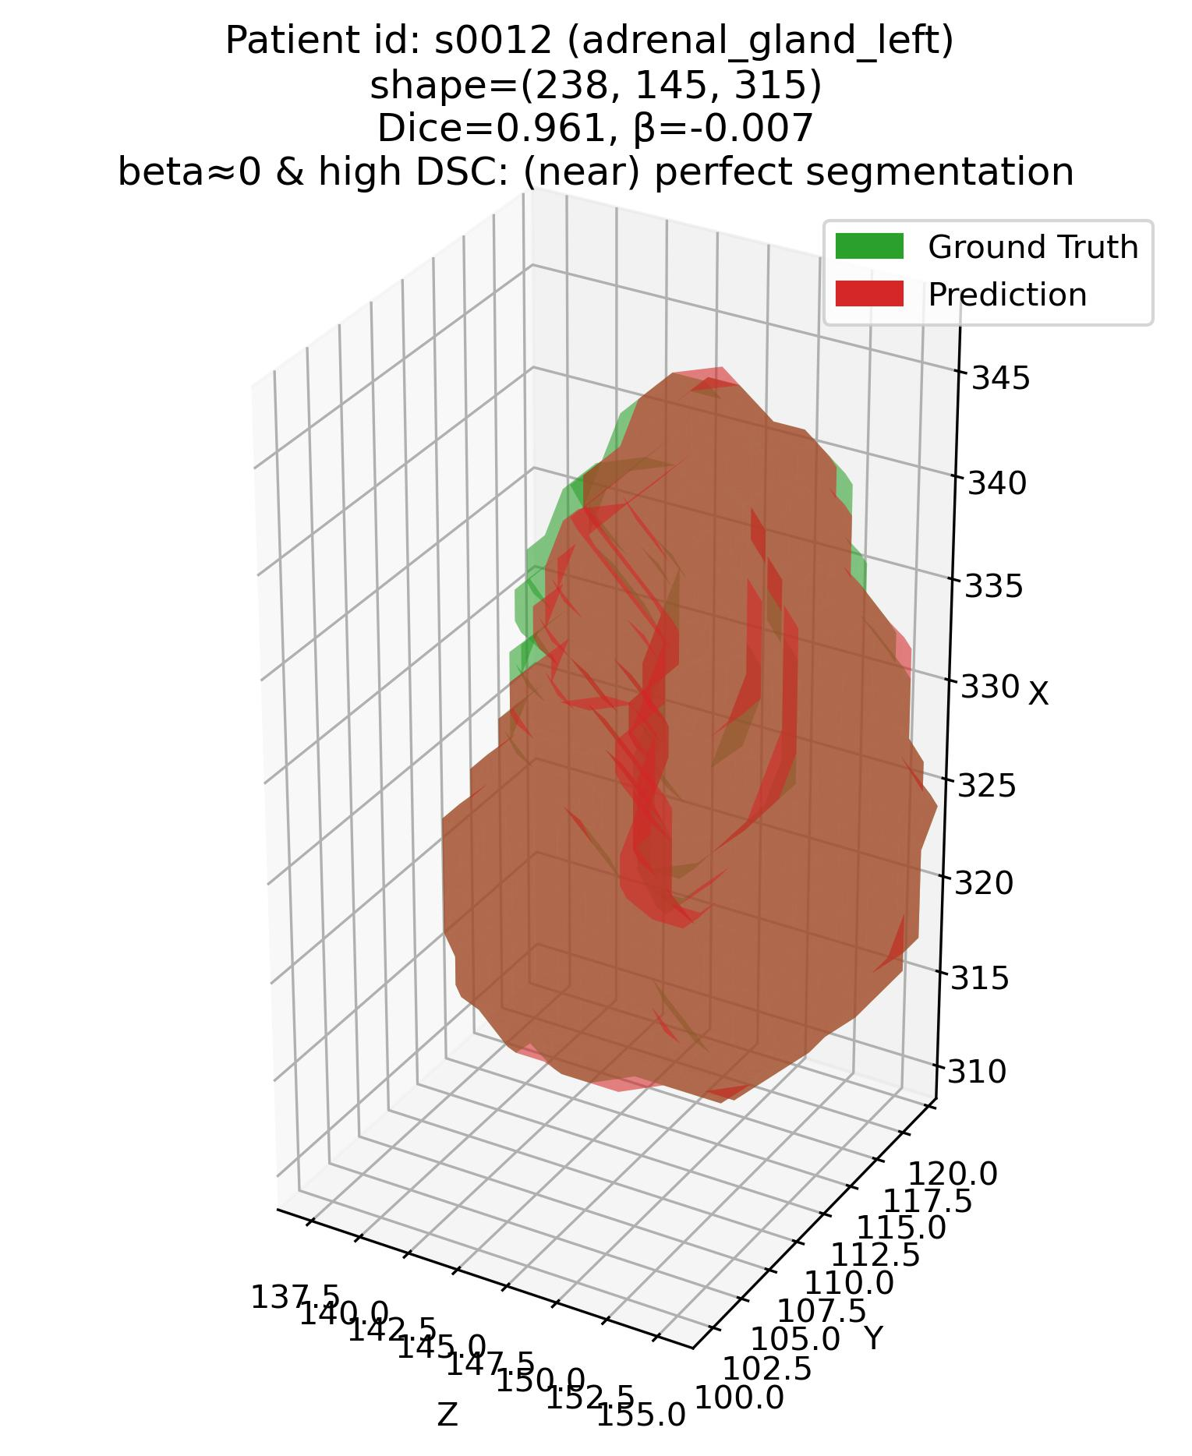
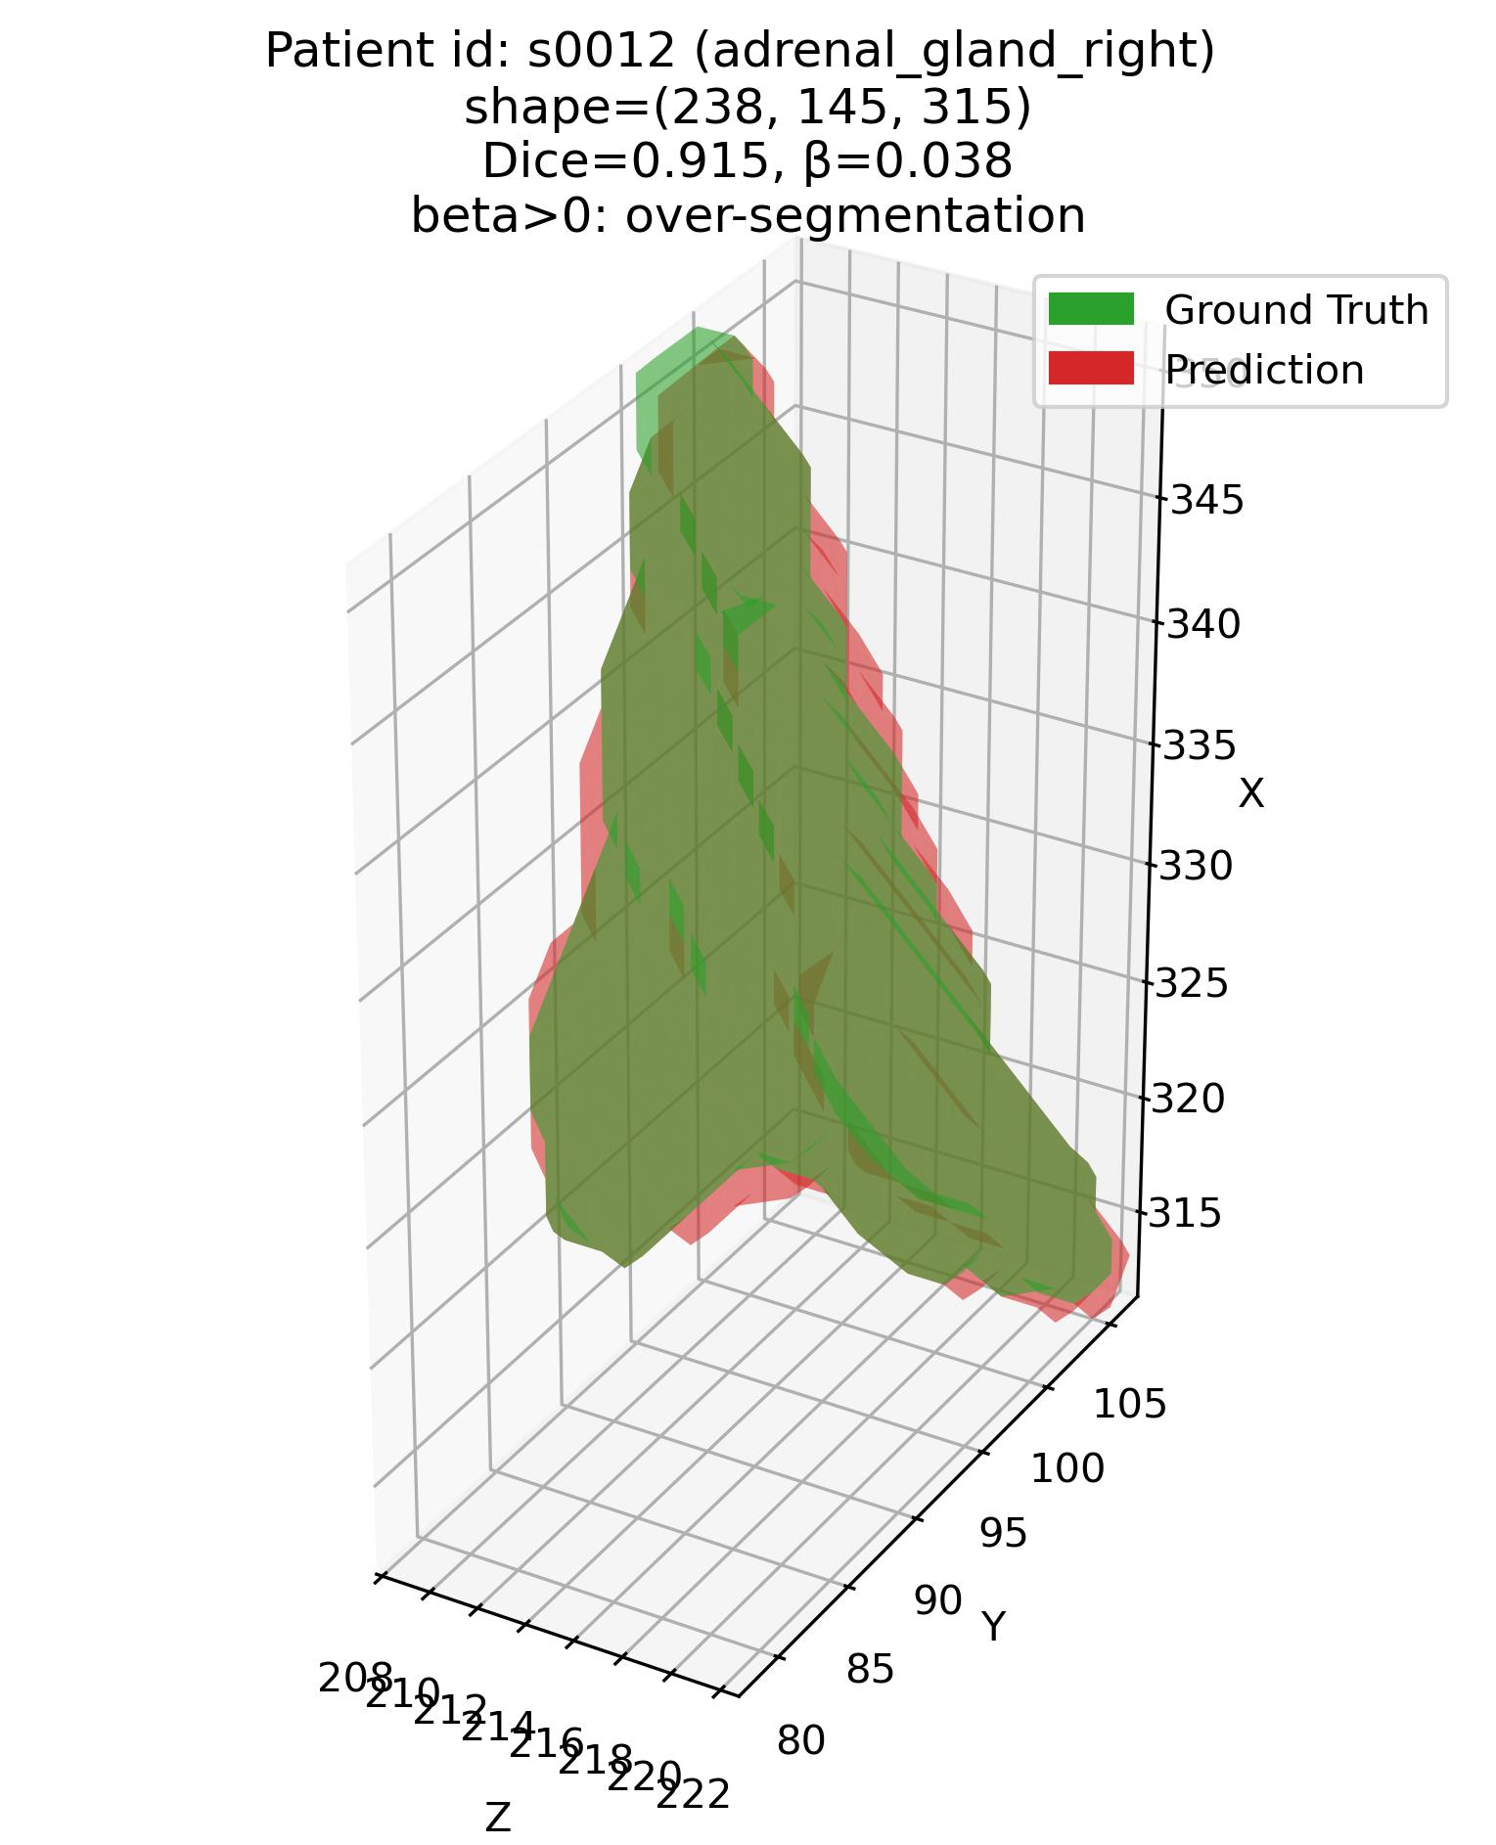
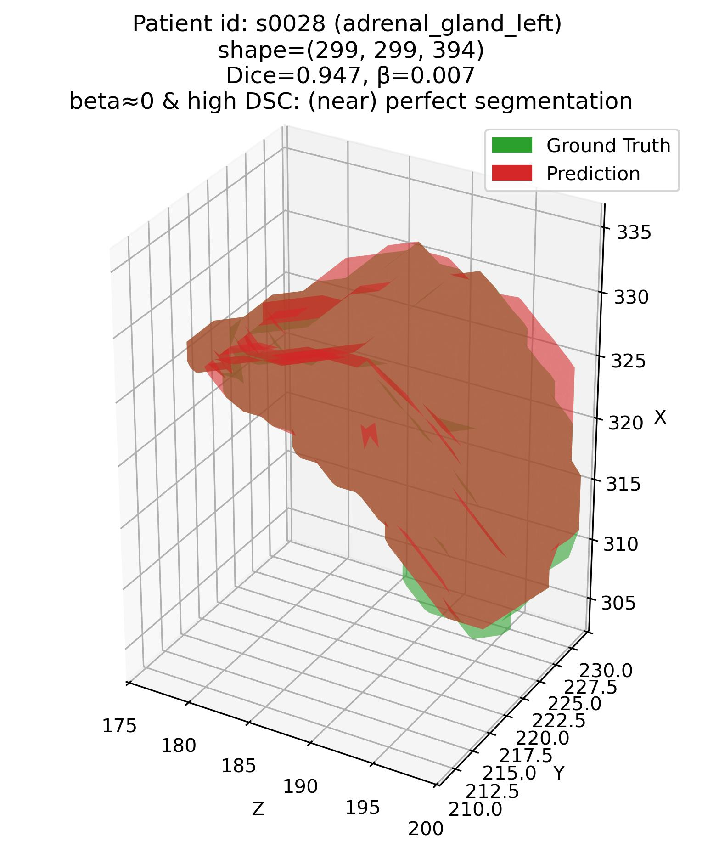
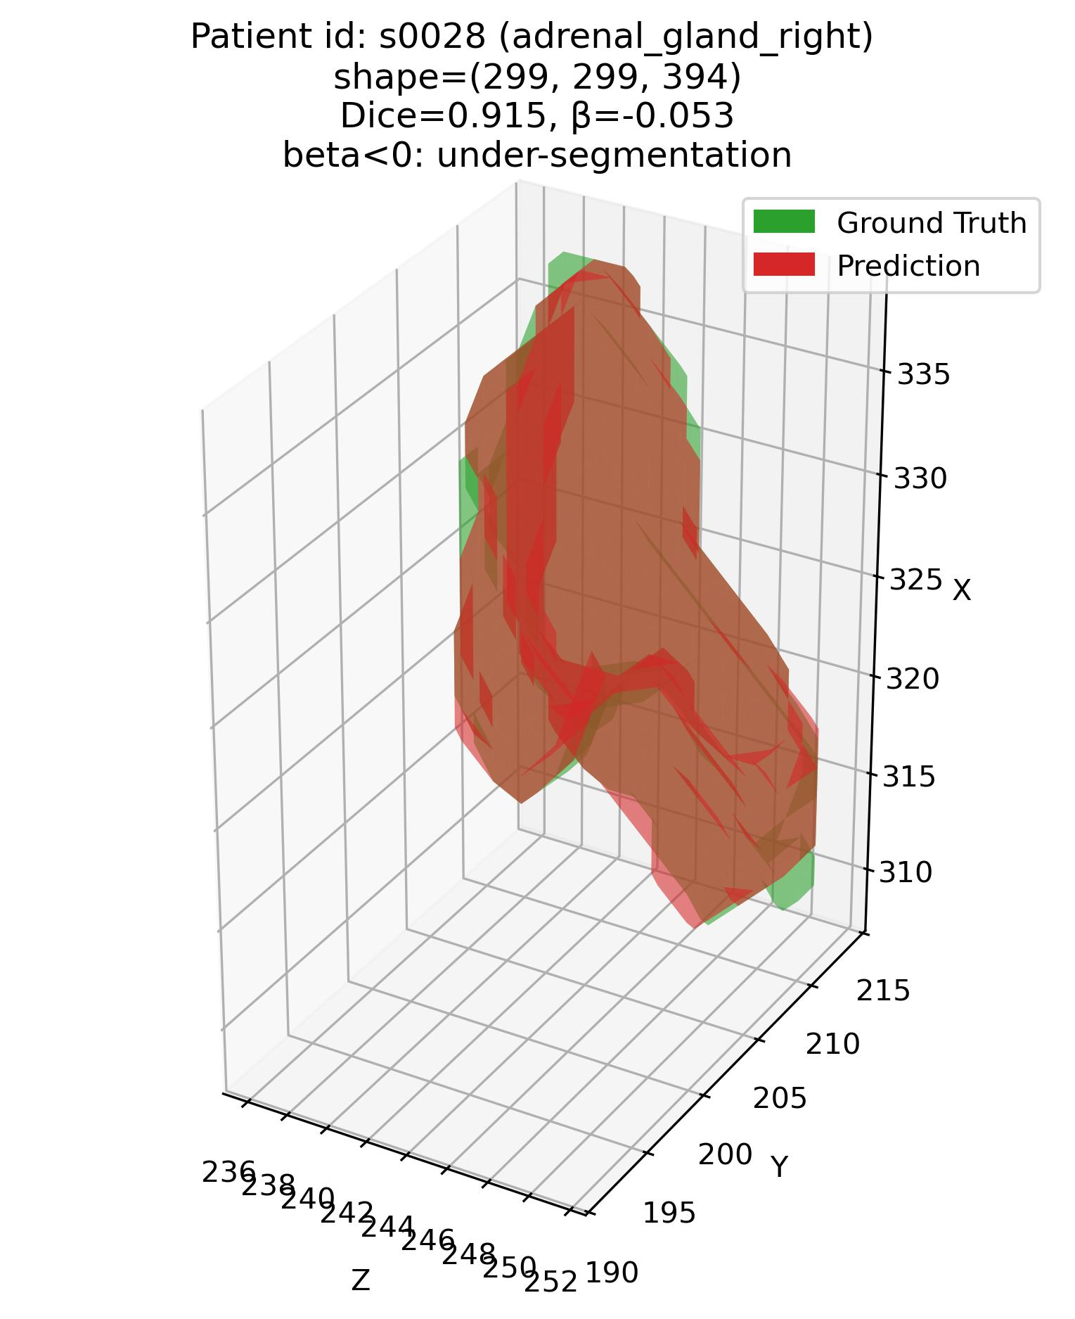
Error characterization protocol
The analysis framework – Q1
Q1: Some examples – 1. Adrenal glands
Patient# s0012 (adrenal glands)
Patient# s0028 (adrenal glands)

Slide 5
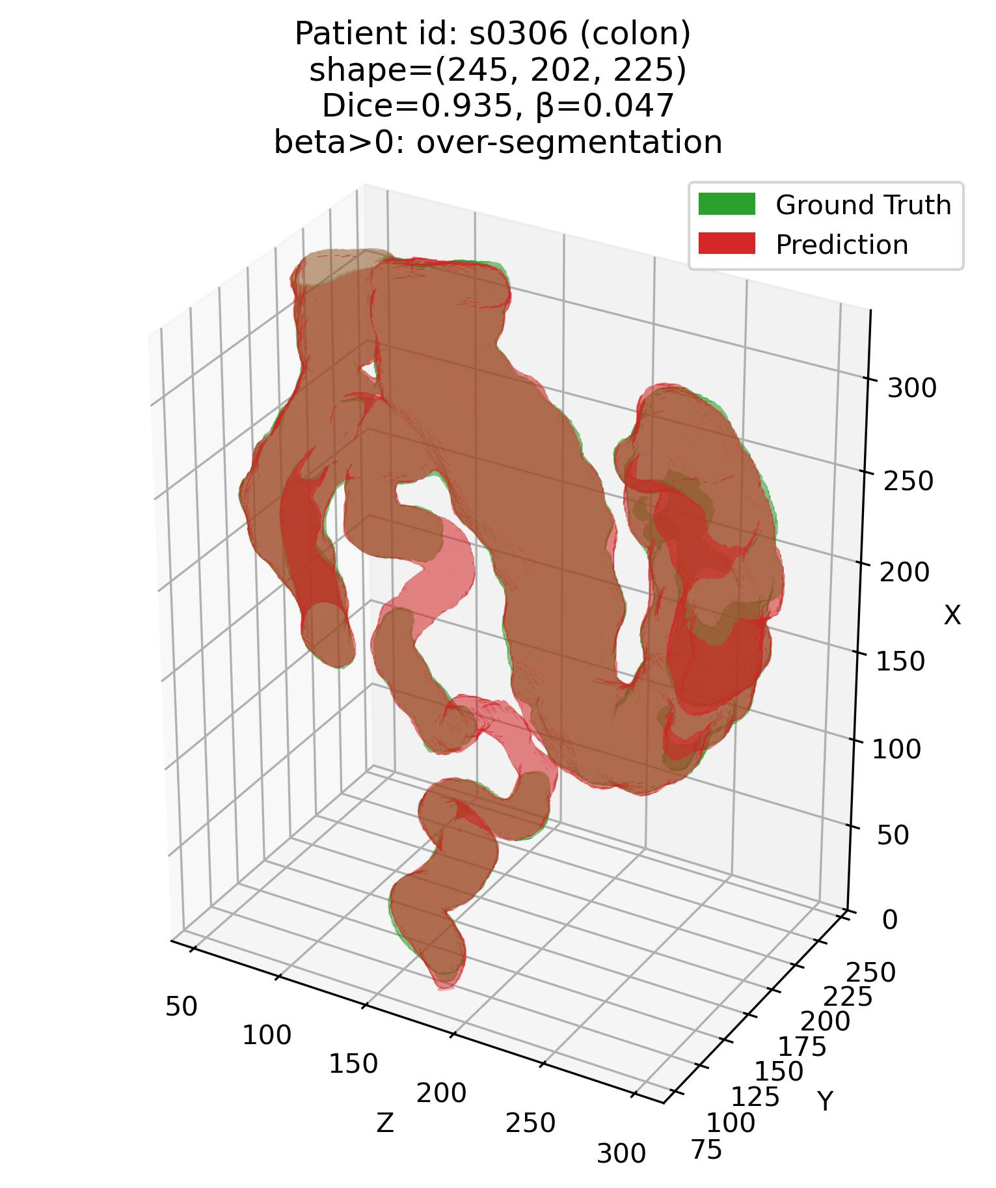
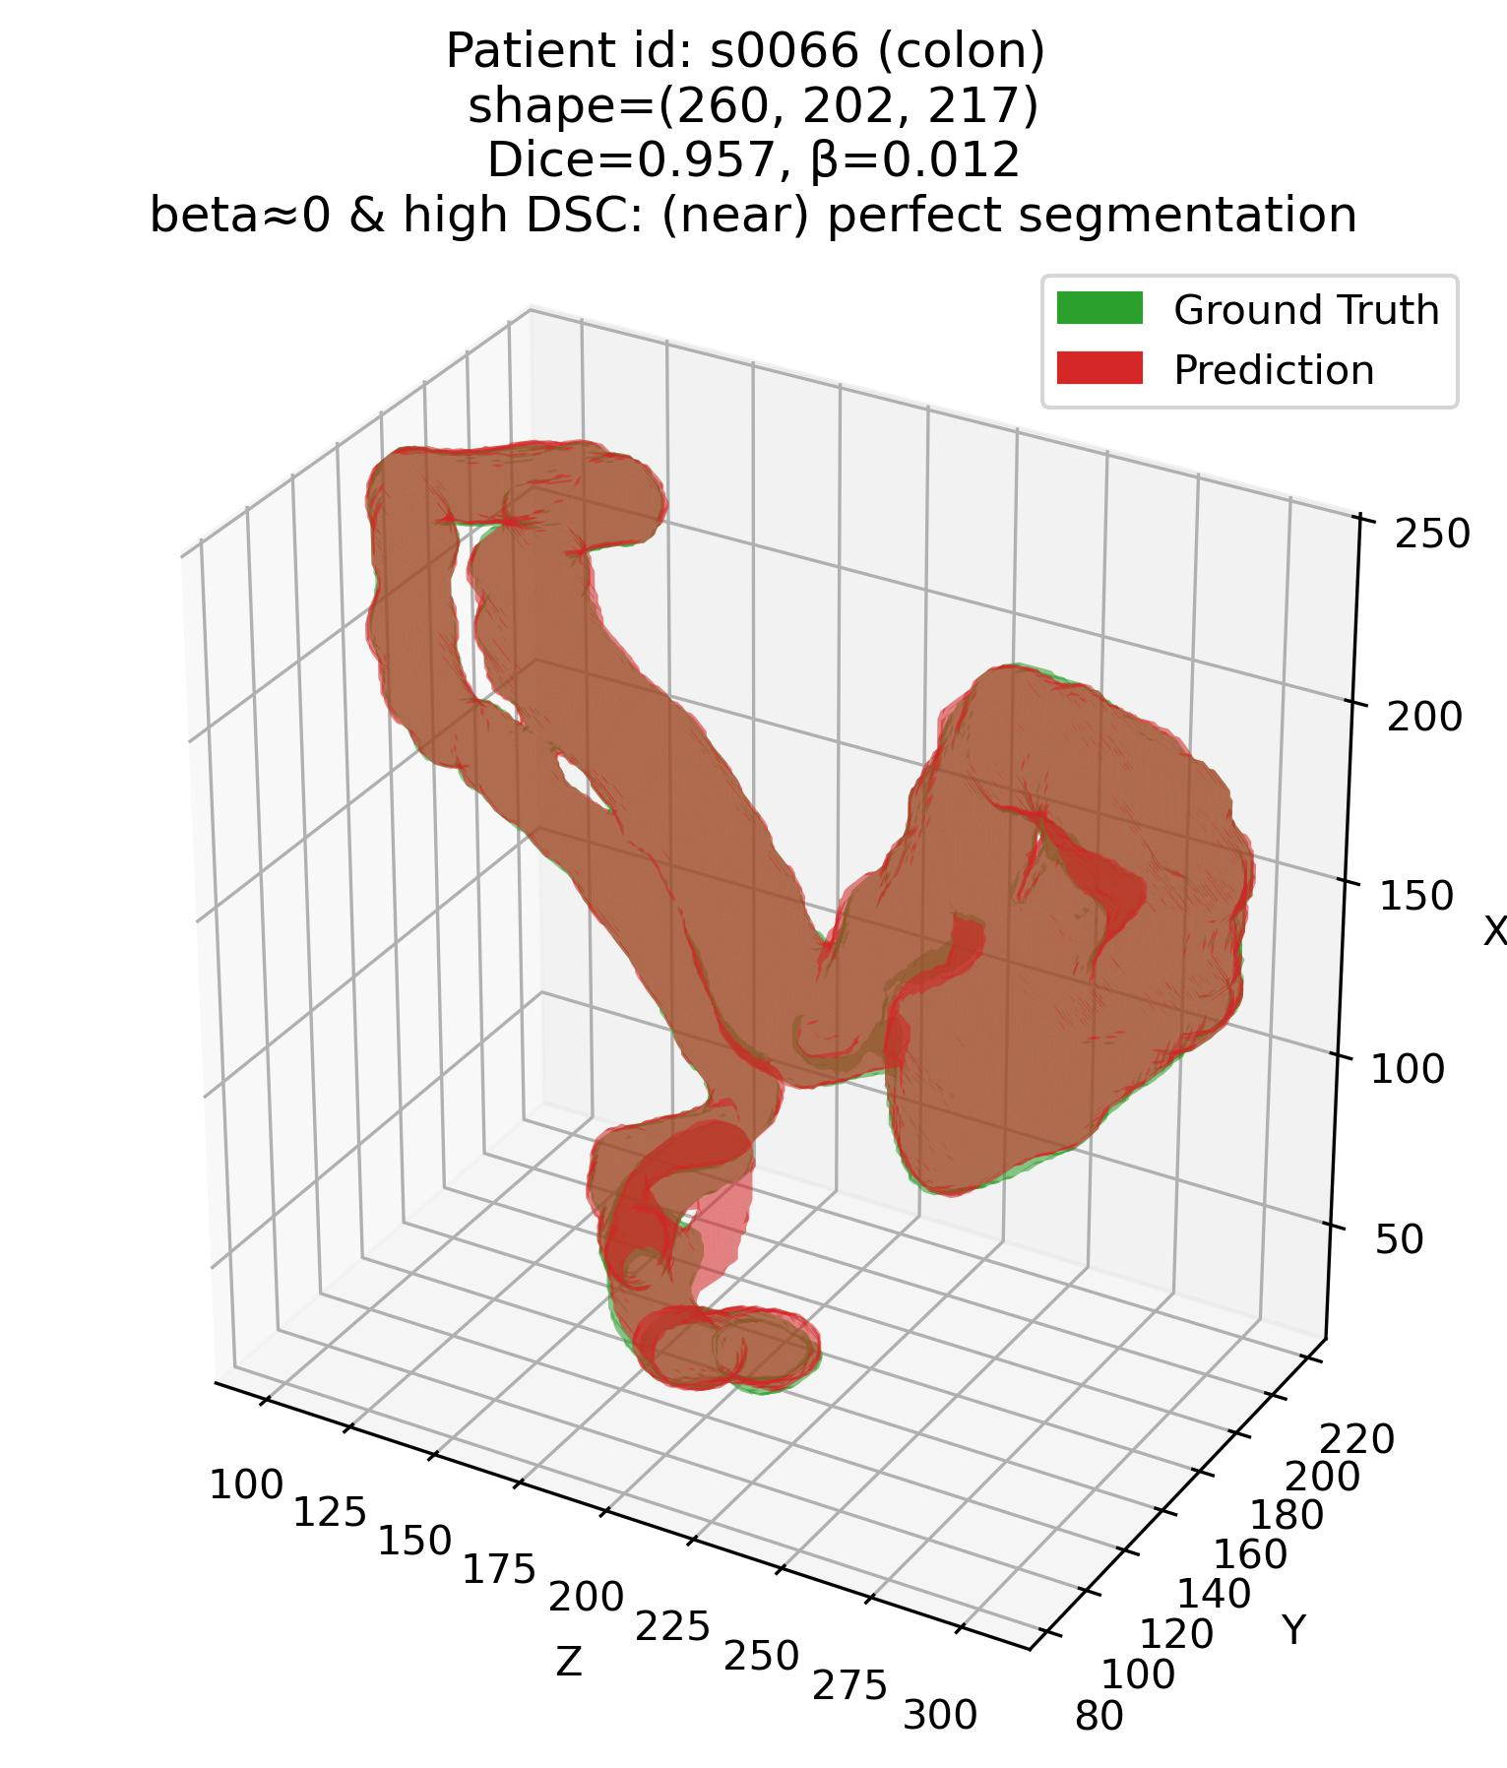
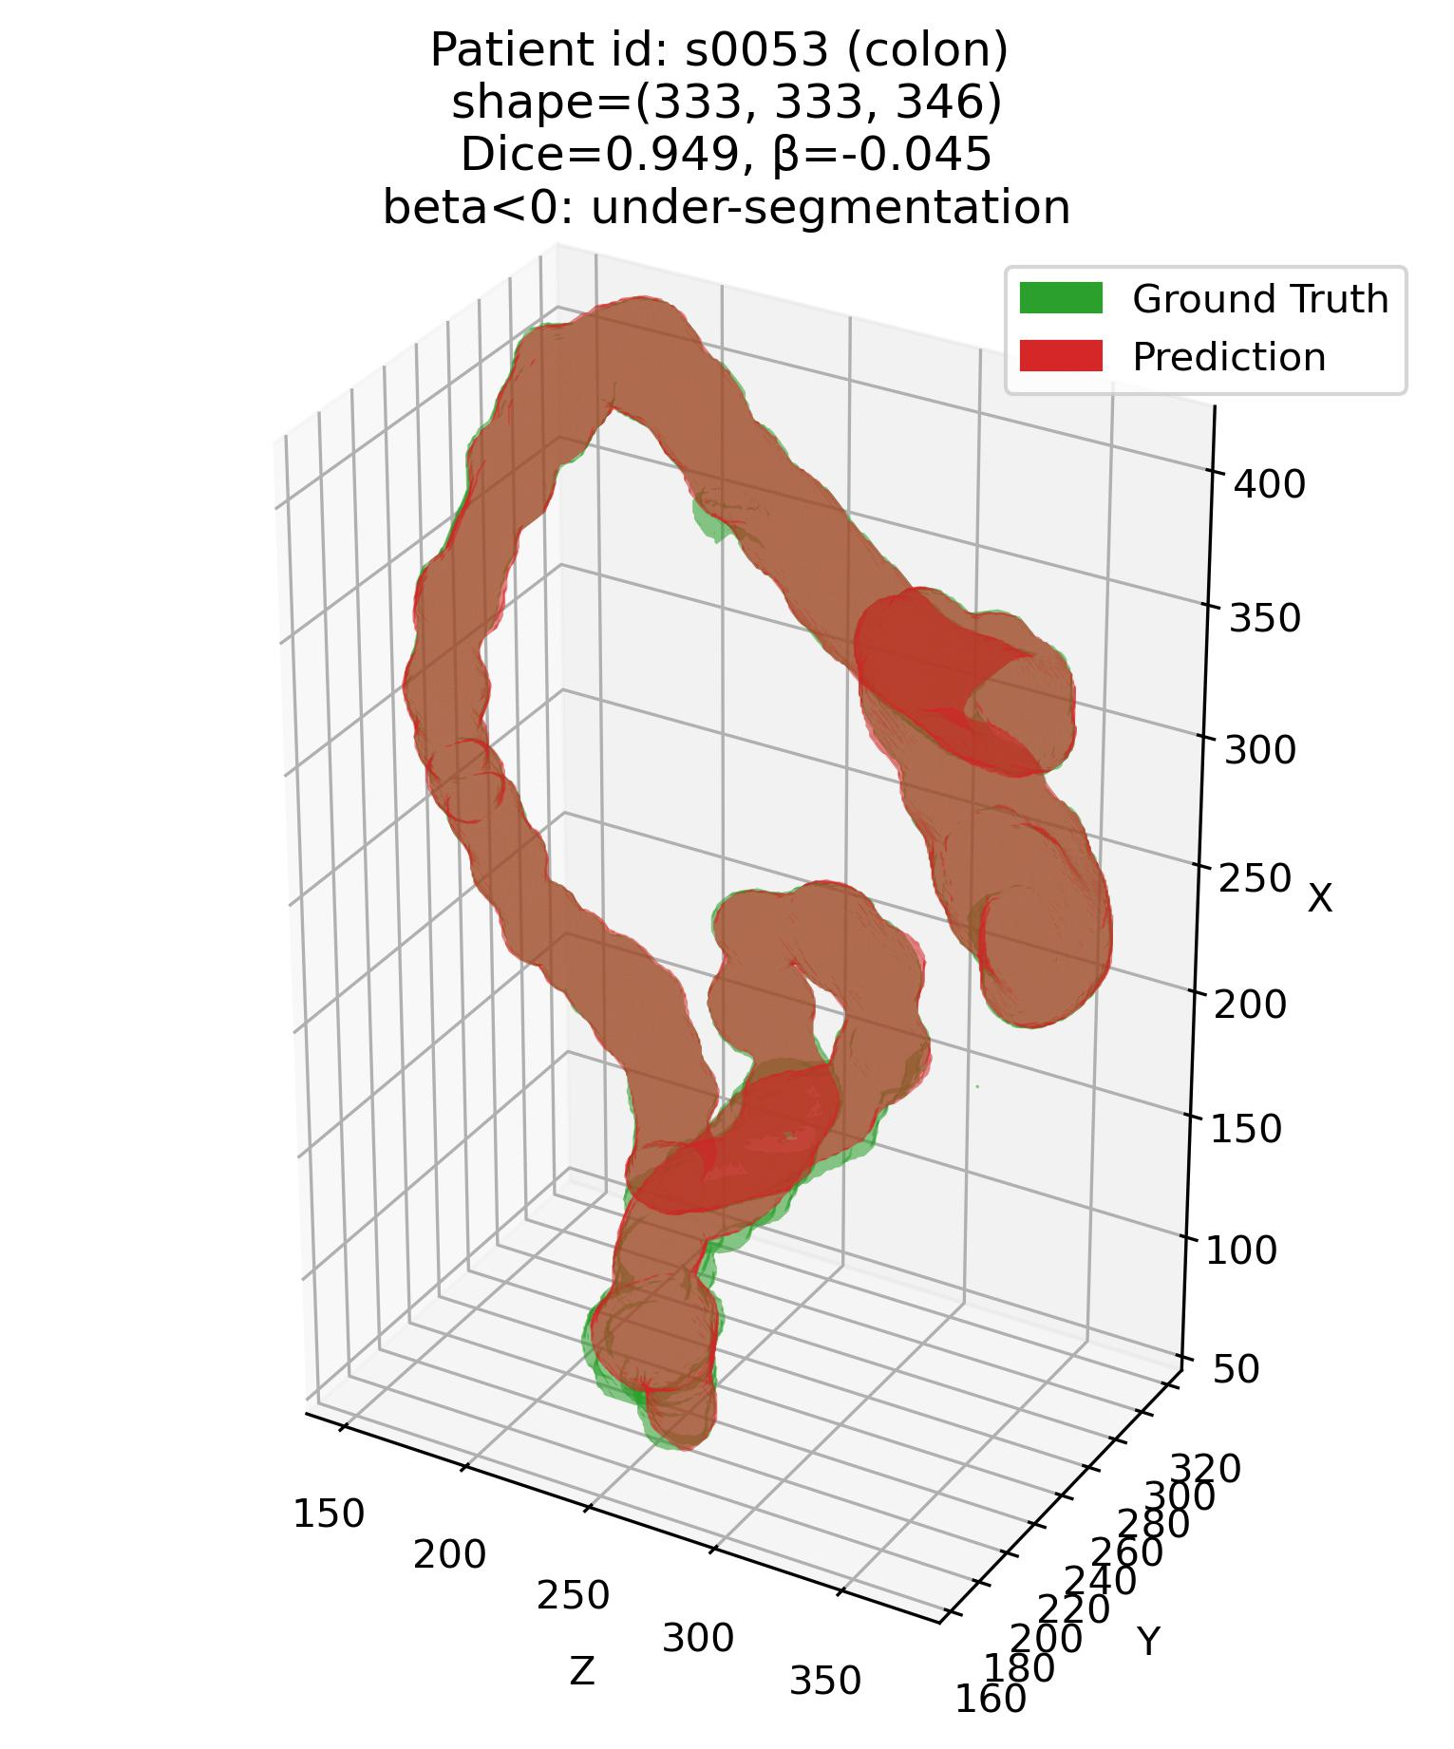
Error characterization protocol
The analysis framework – Q1
Q1: Some examples – 2. Colon

Slide 6
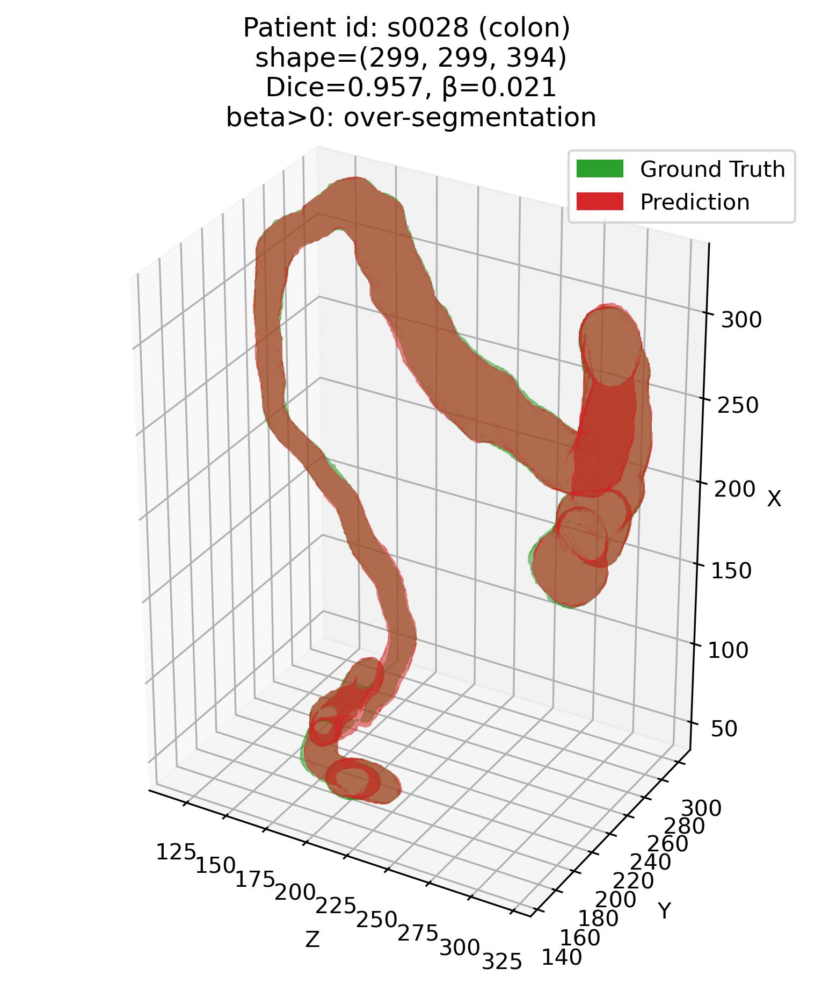
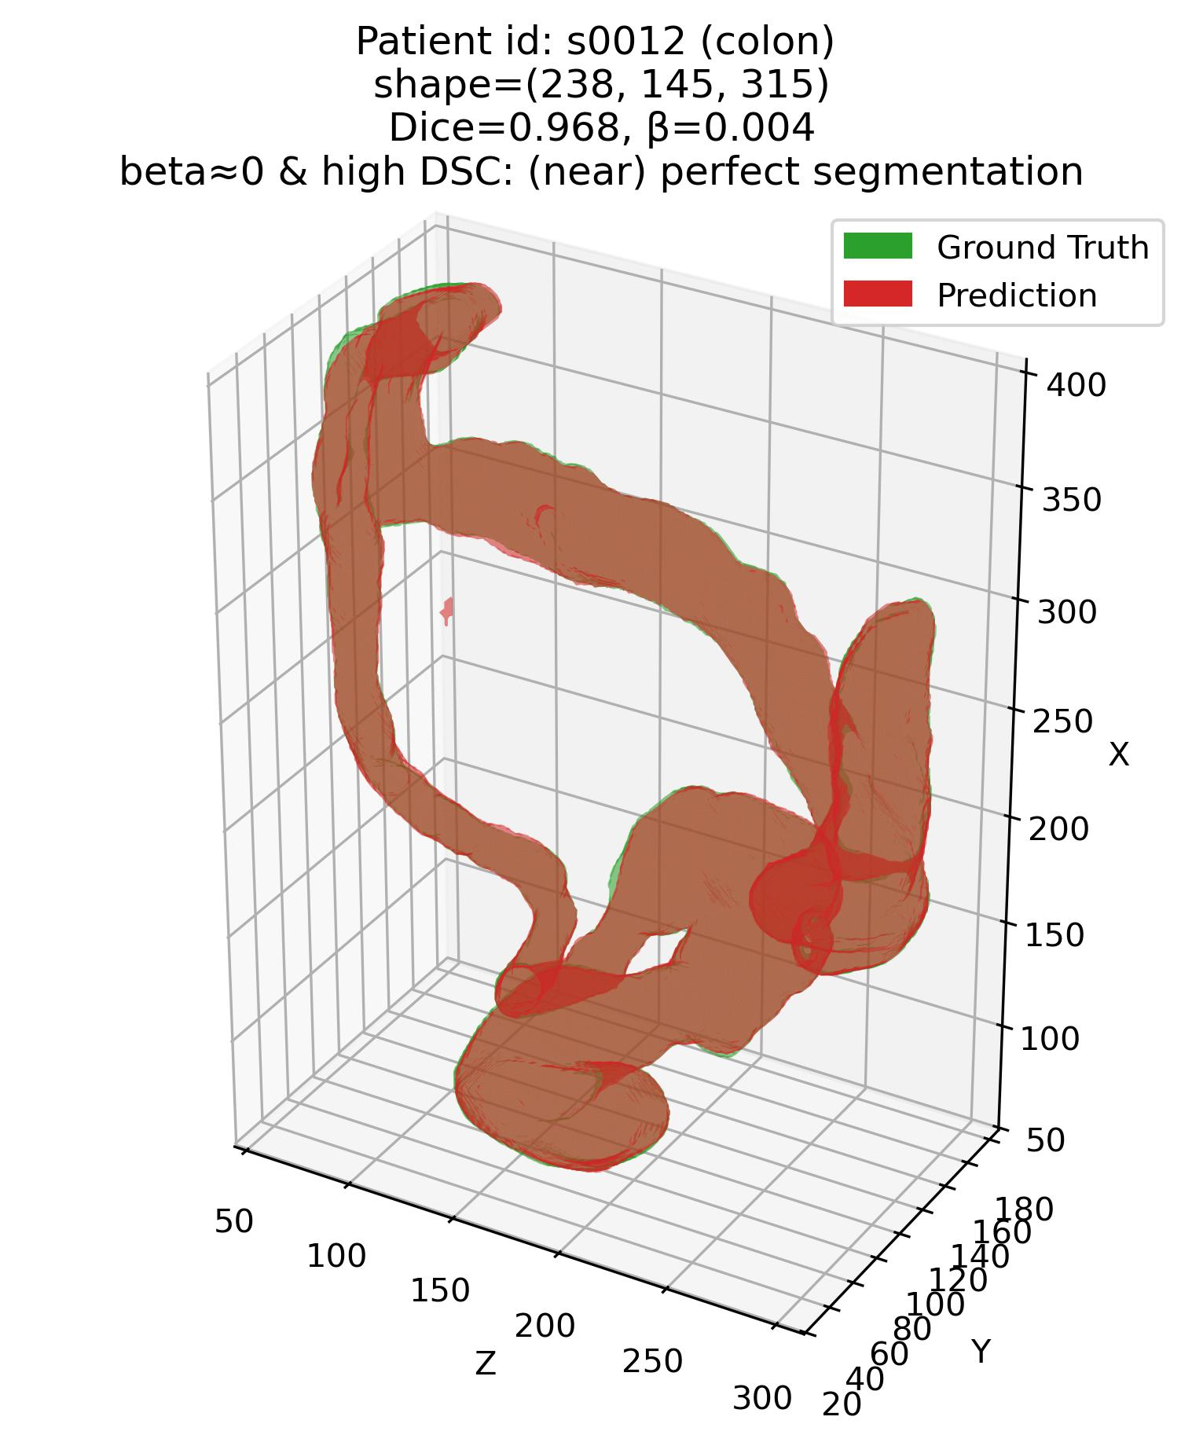
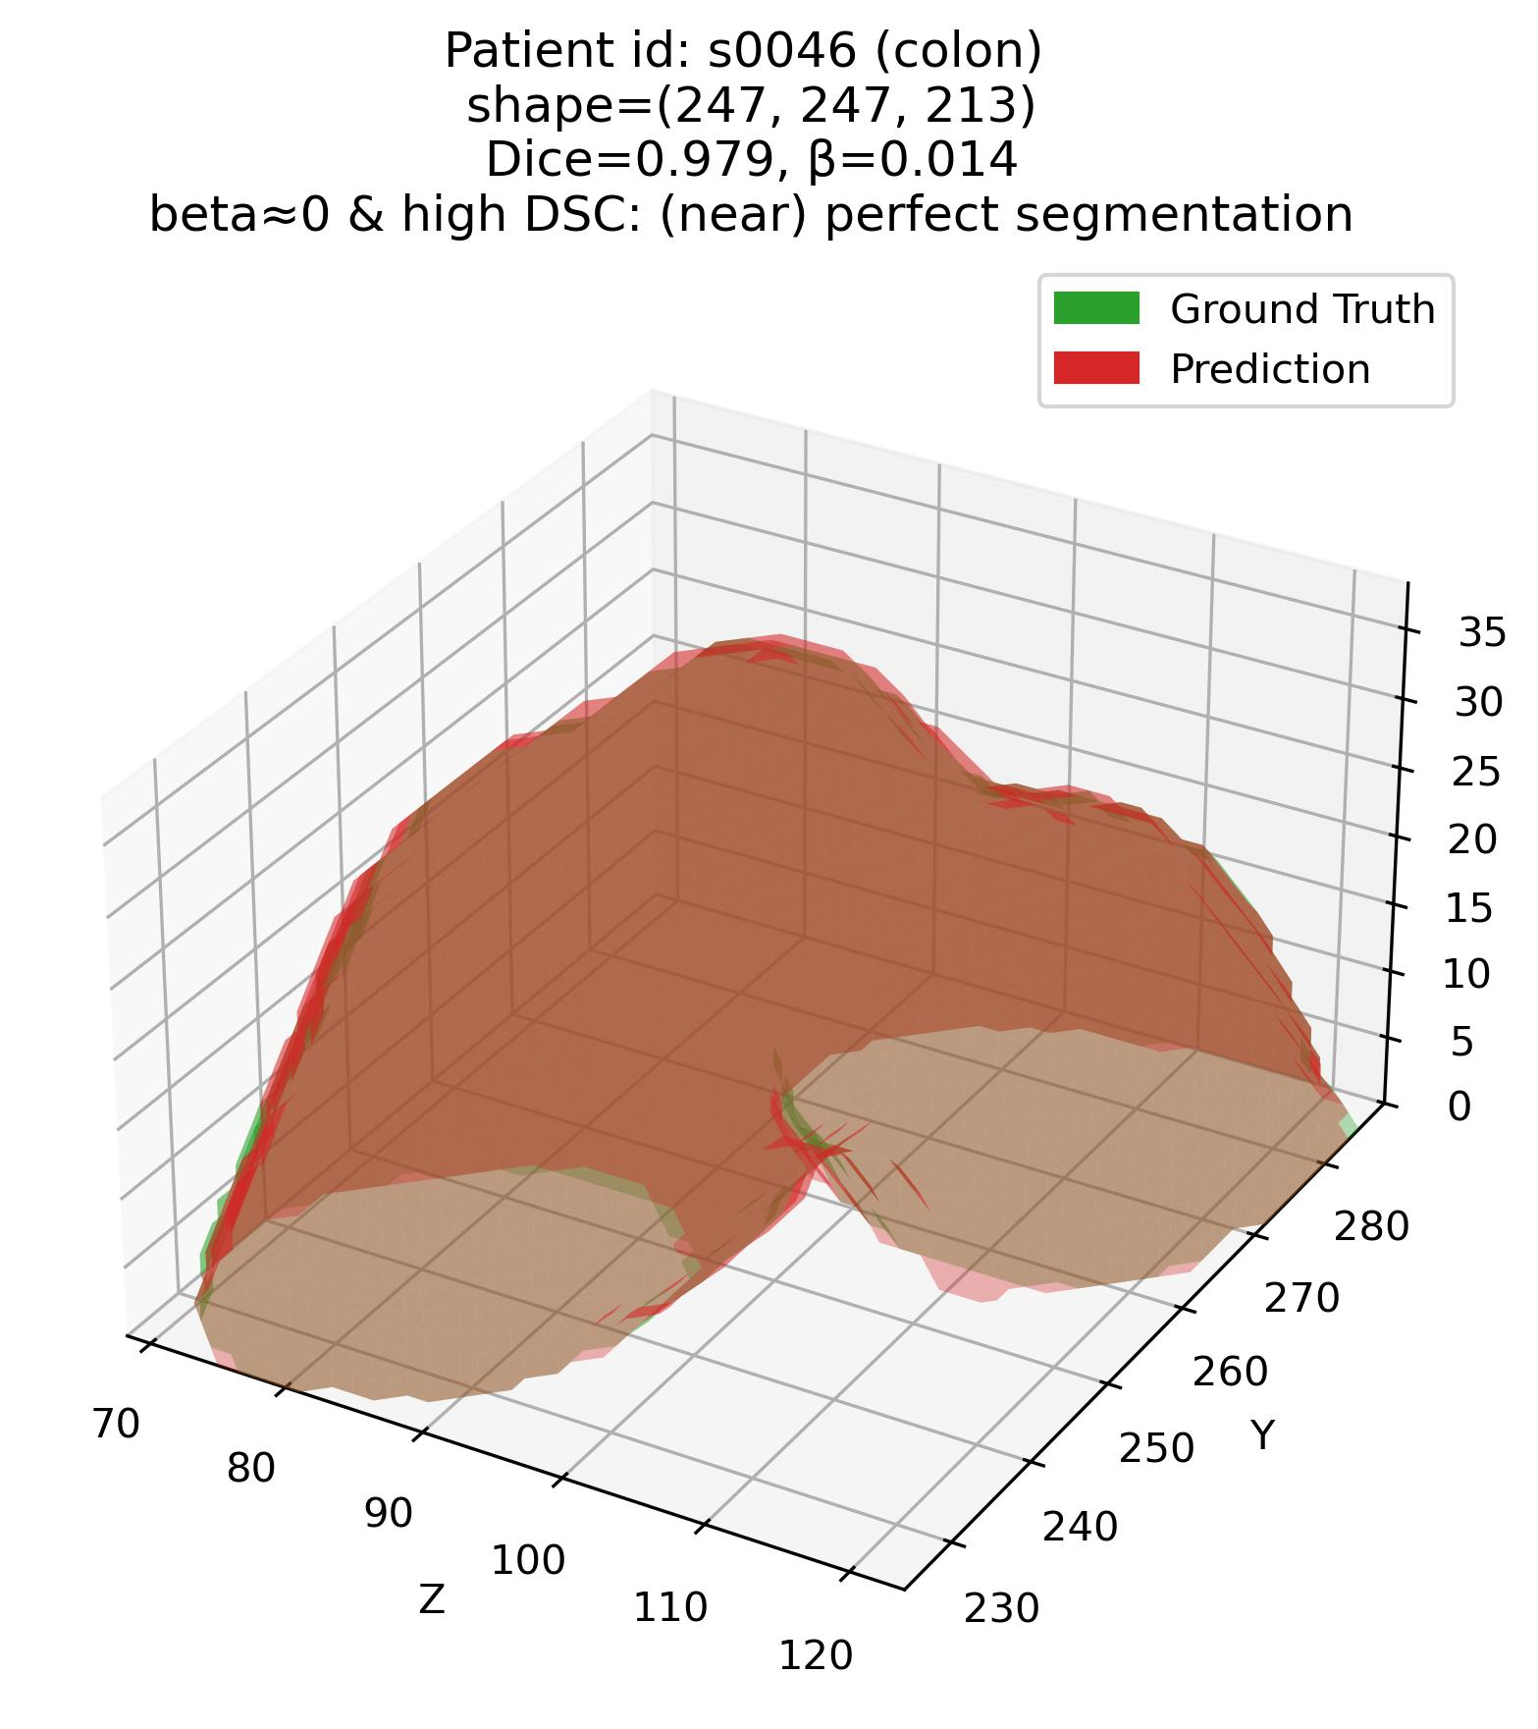
Error characterization protocol
The analysis framework – Q1
Q1: Some examples – 2. Colon

Slide 7
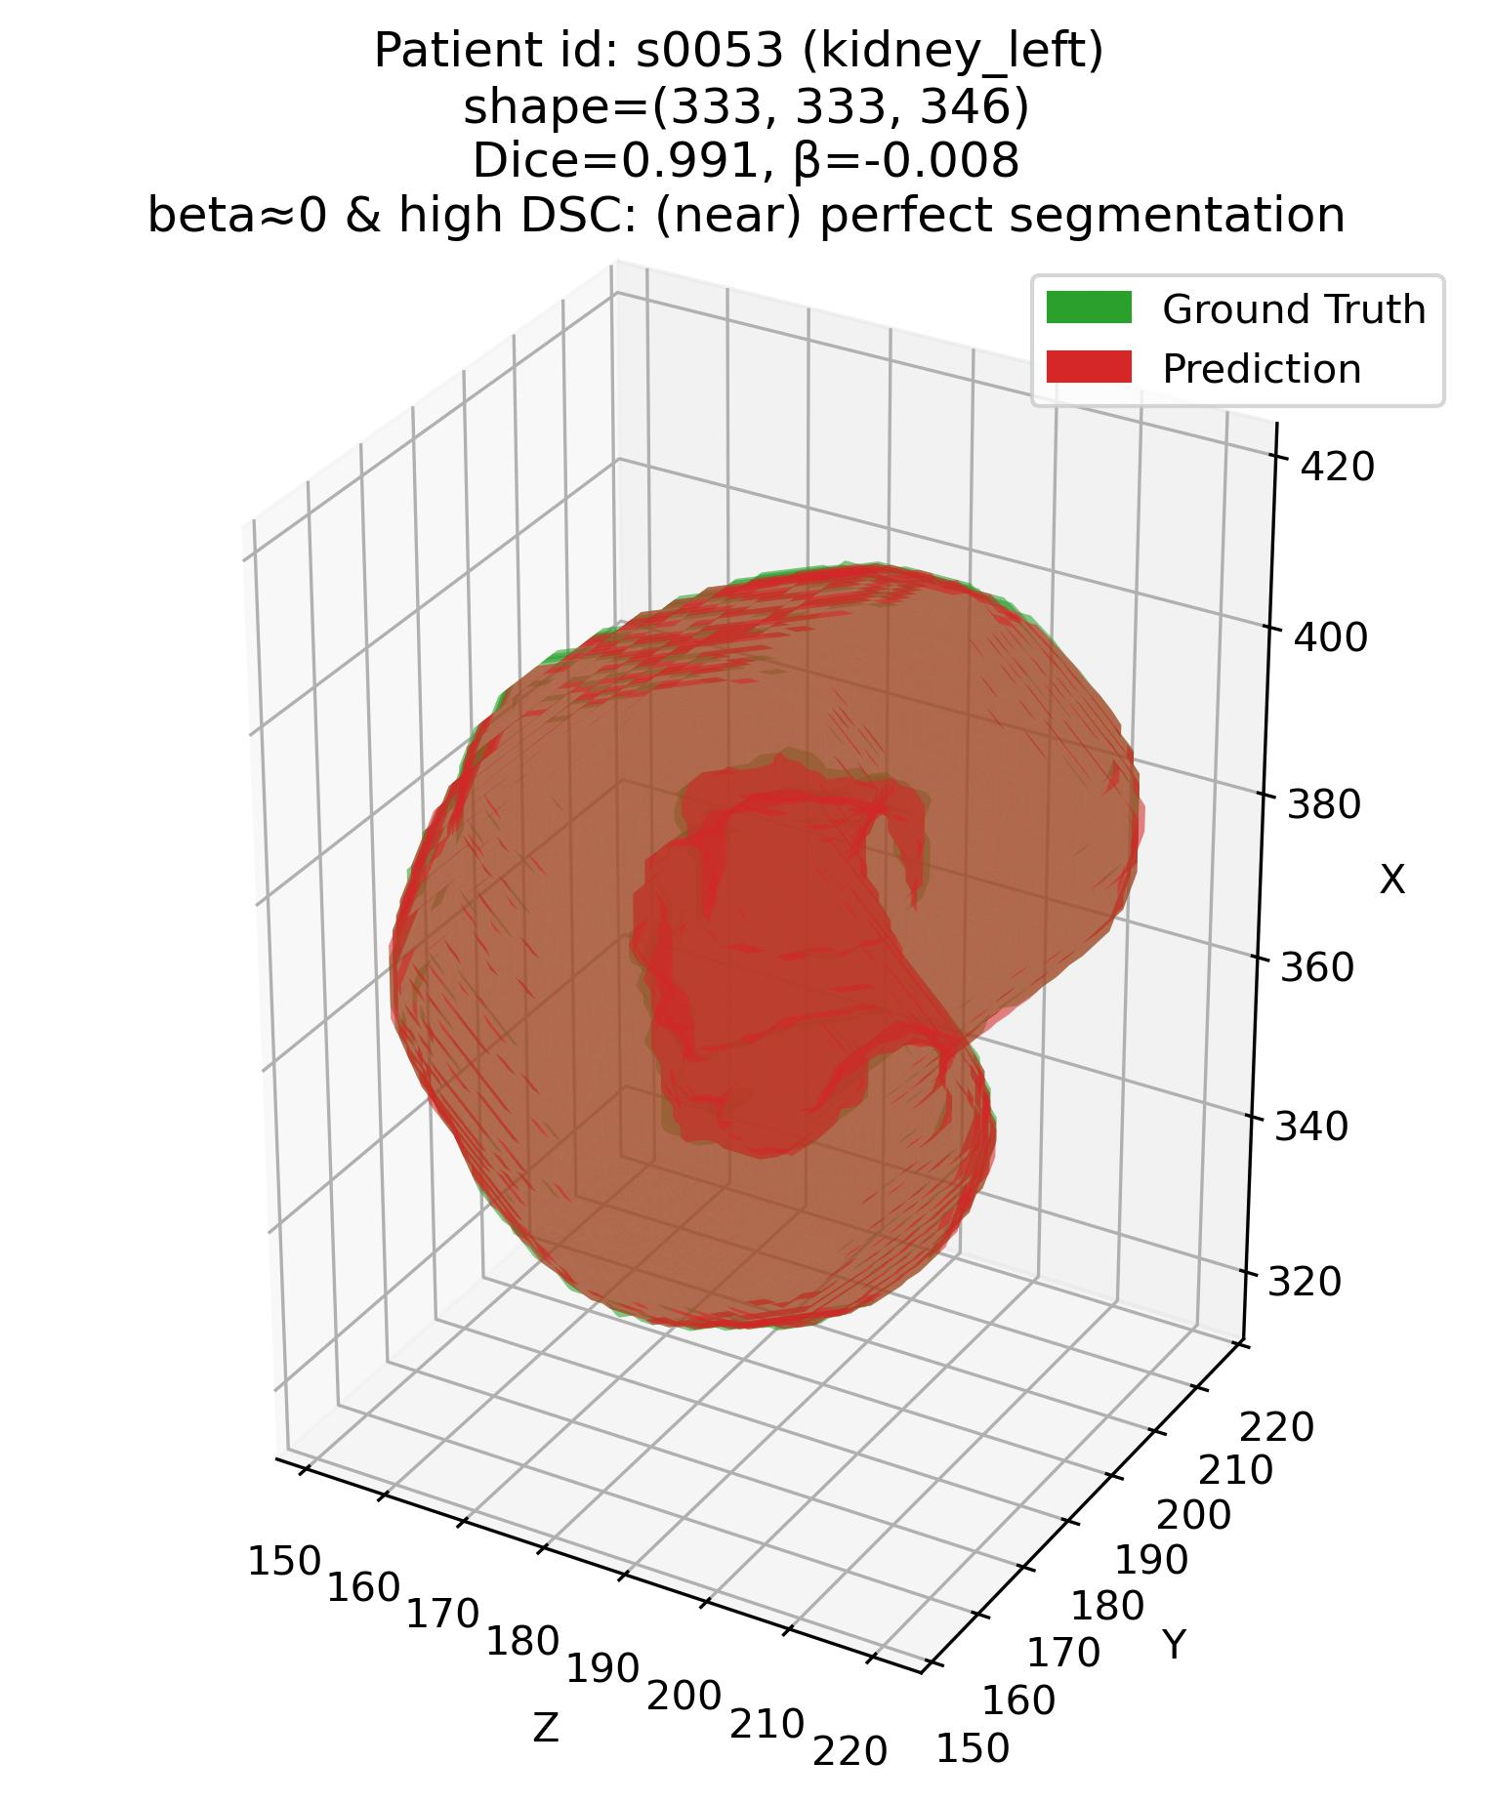
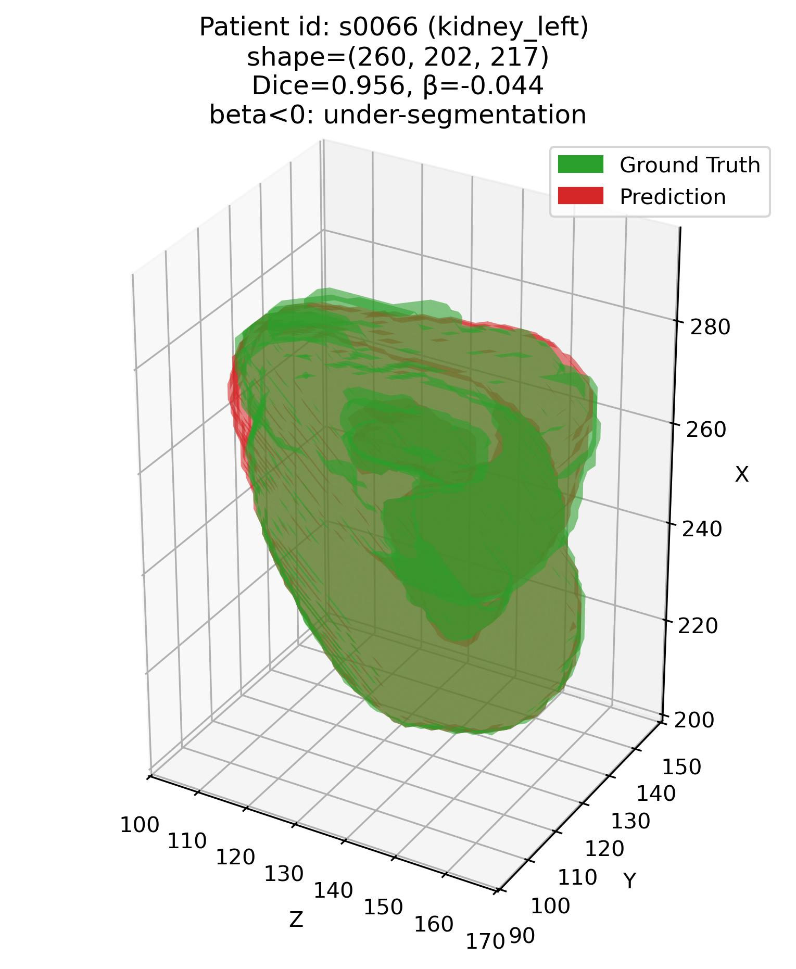
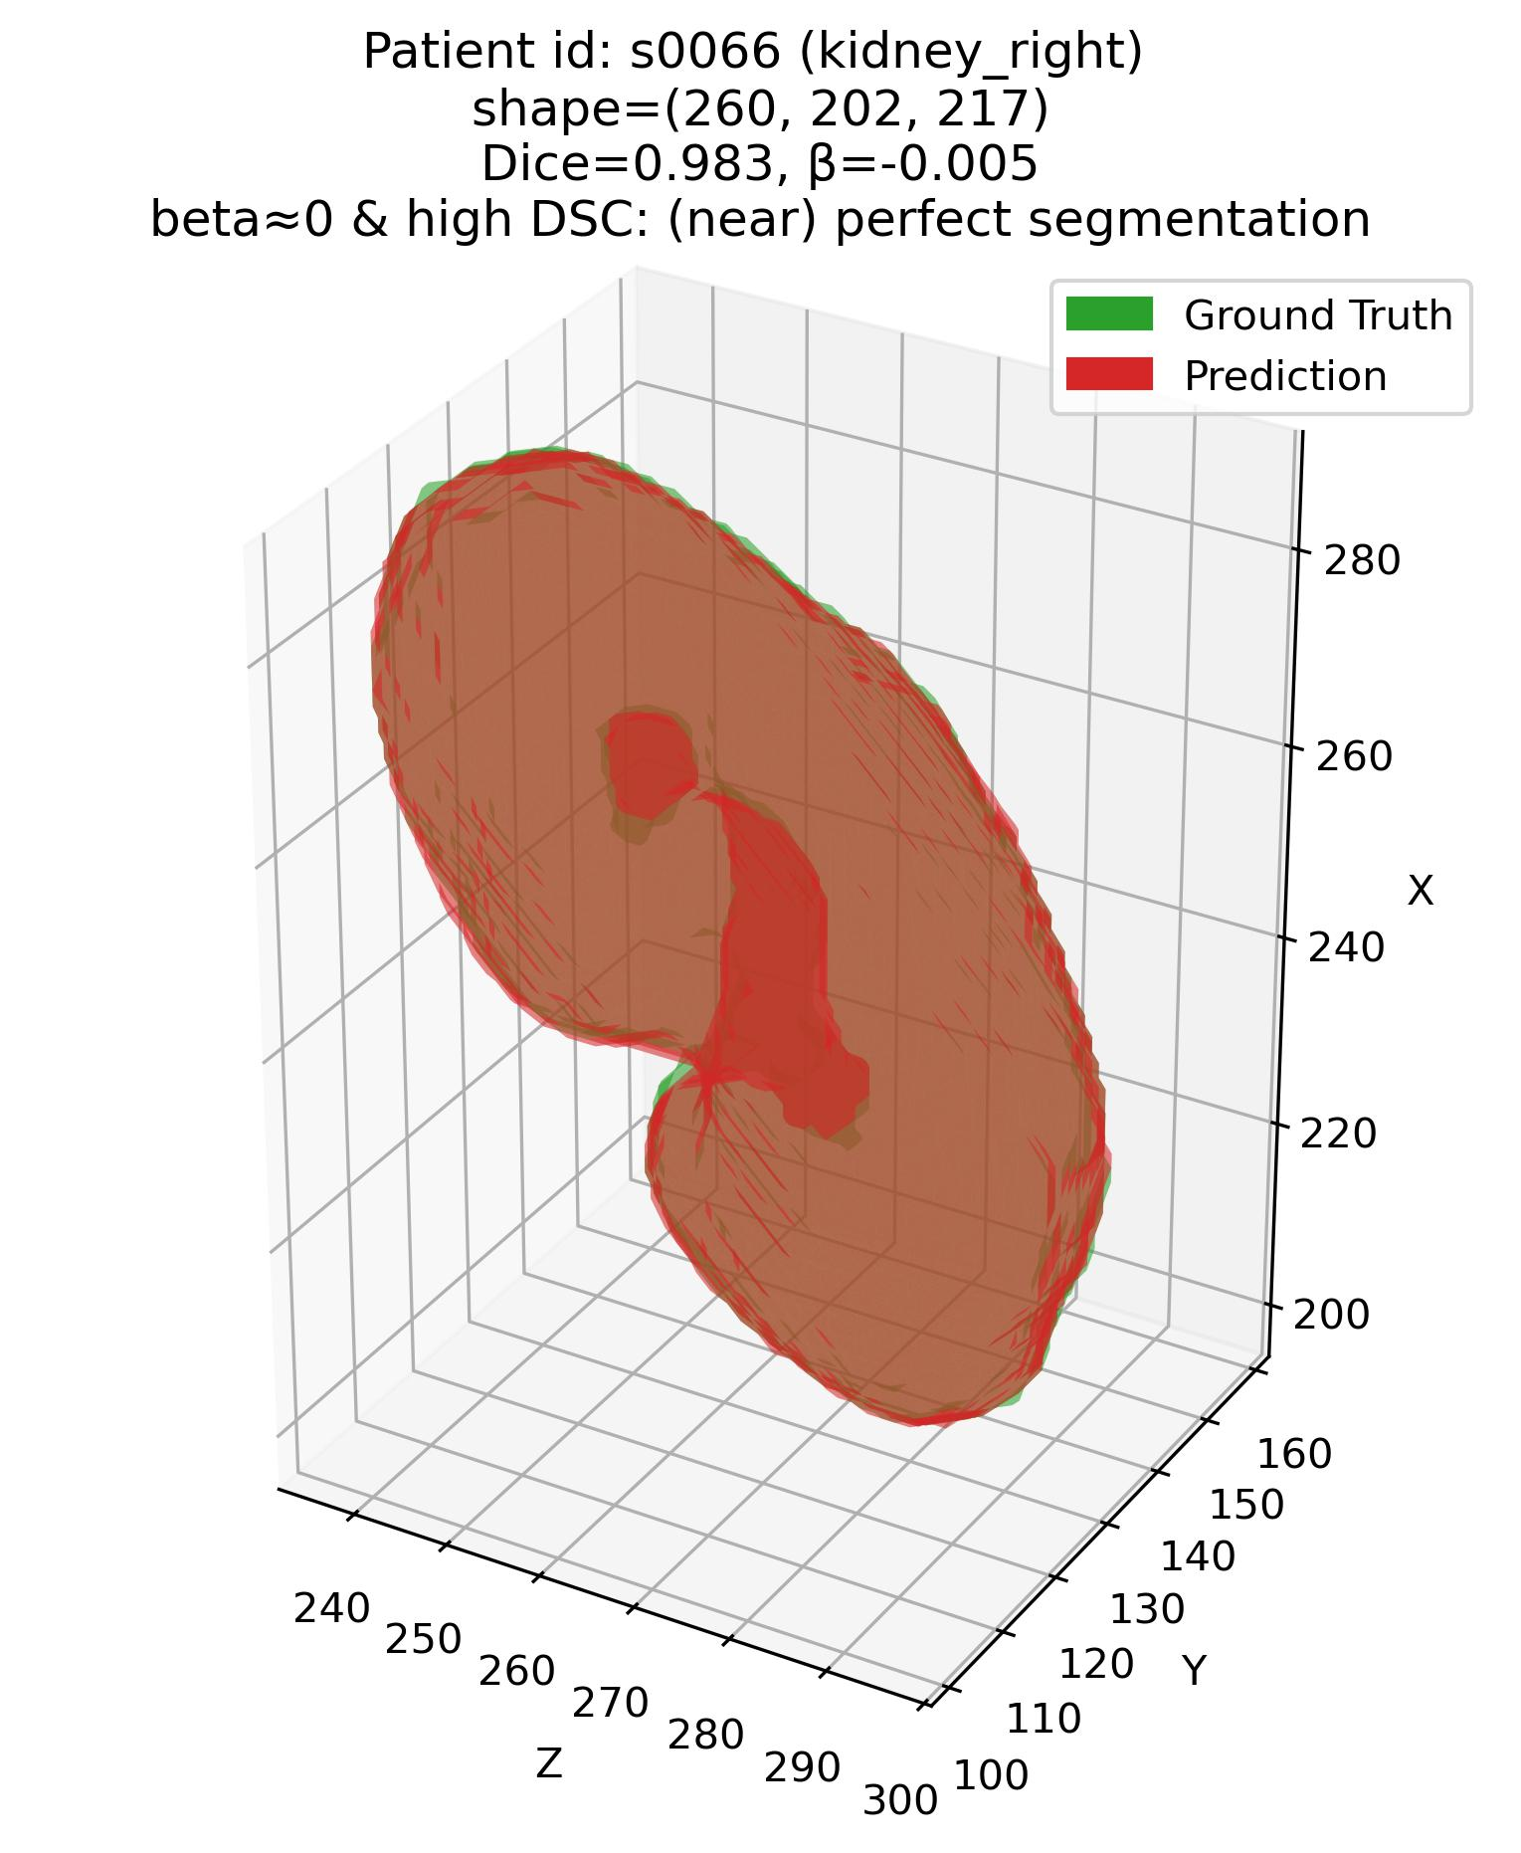
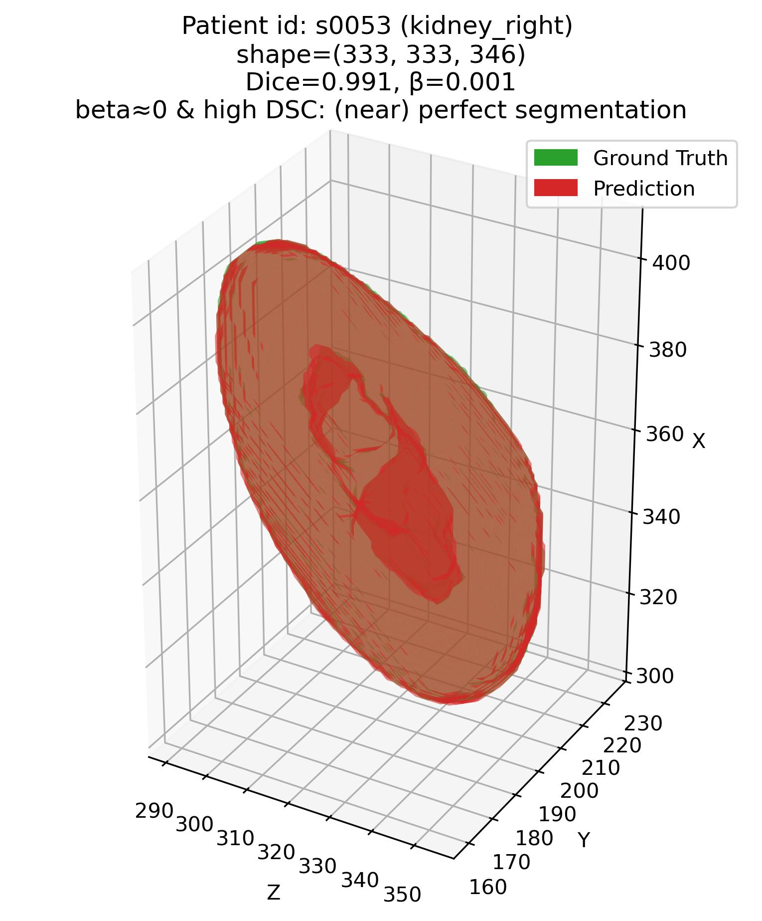
Error characterization protocol
The analysis framework – Q1
Q1: Some examples – 3. Kidneys
Patient# s0053 (Kidneys)
Patient# s0066 (Kidneys)

Slide 8
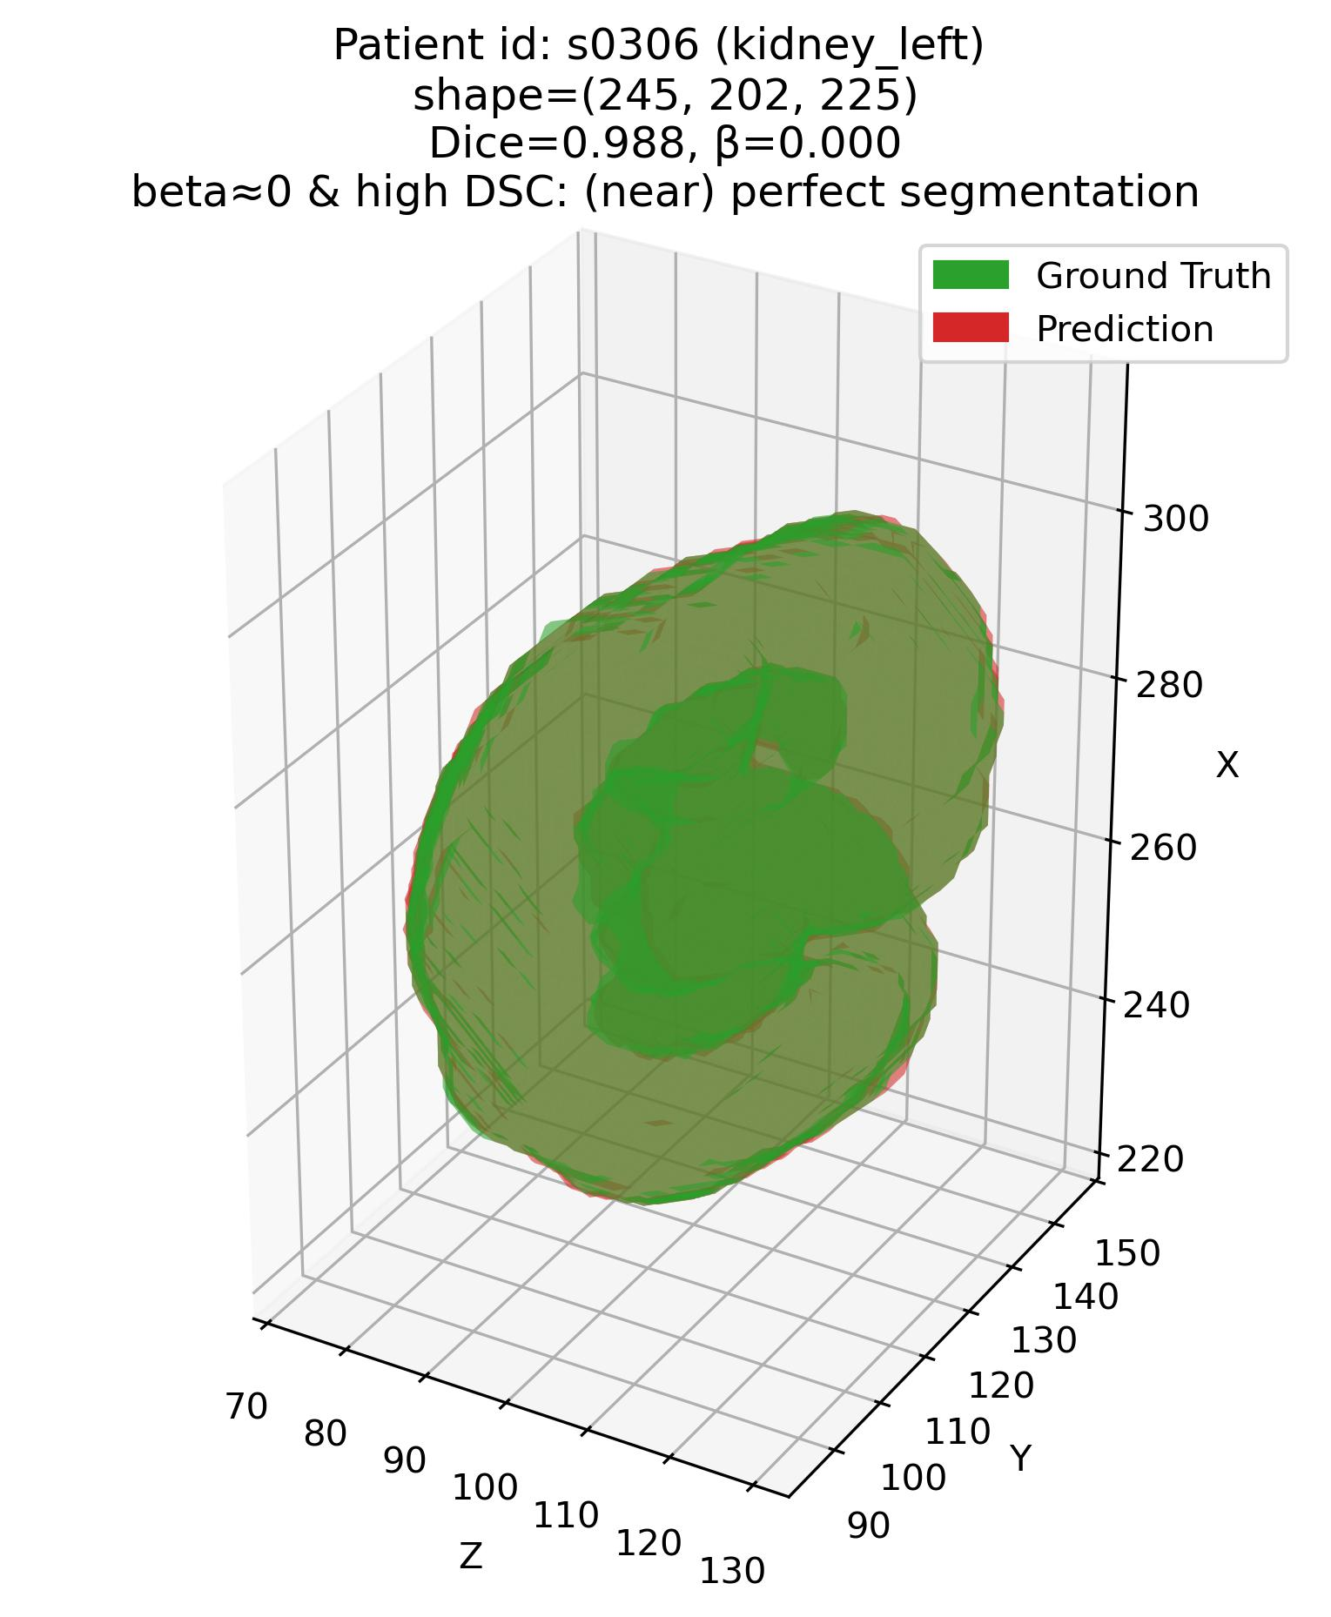
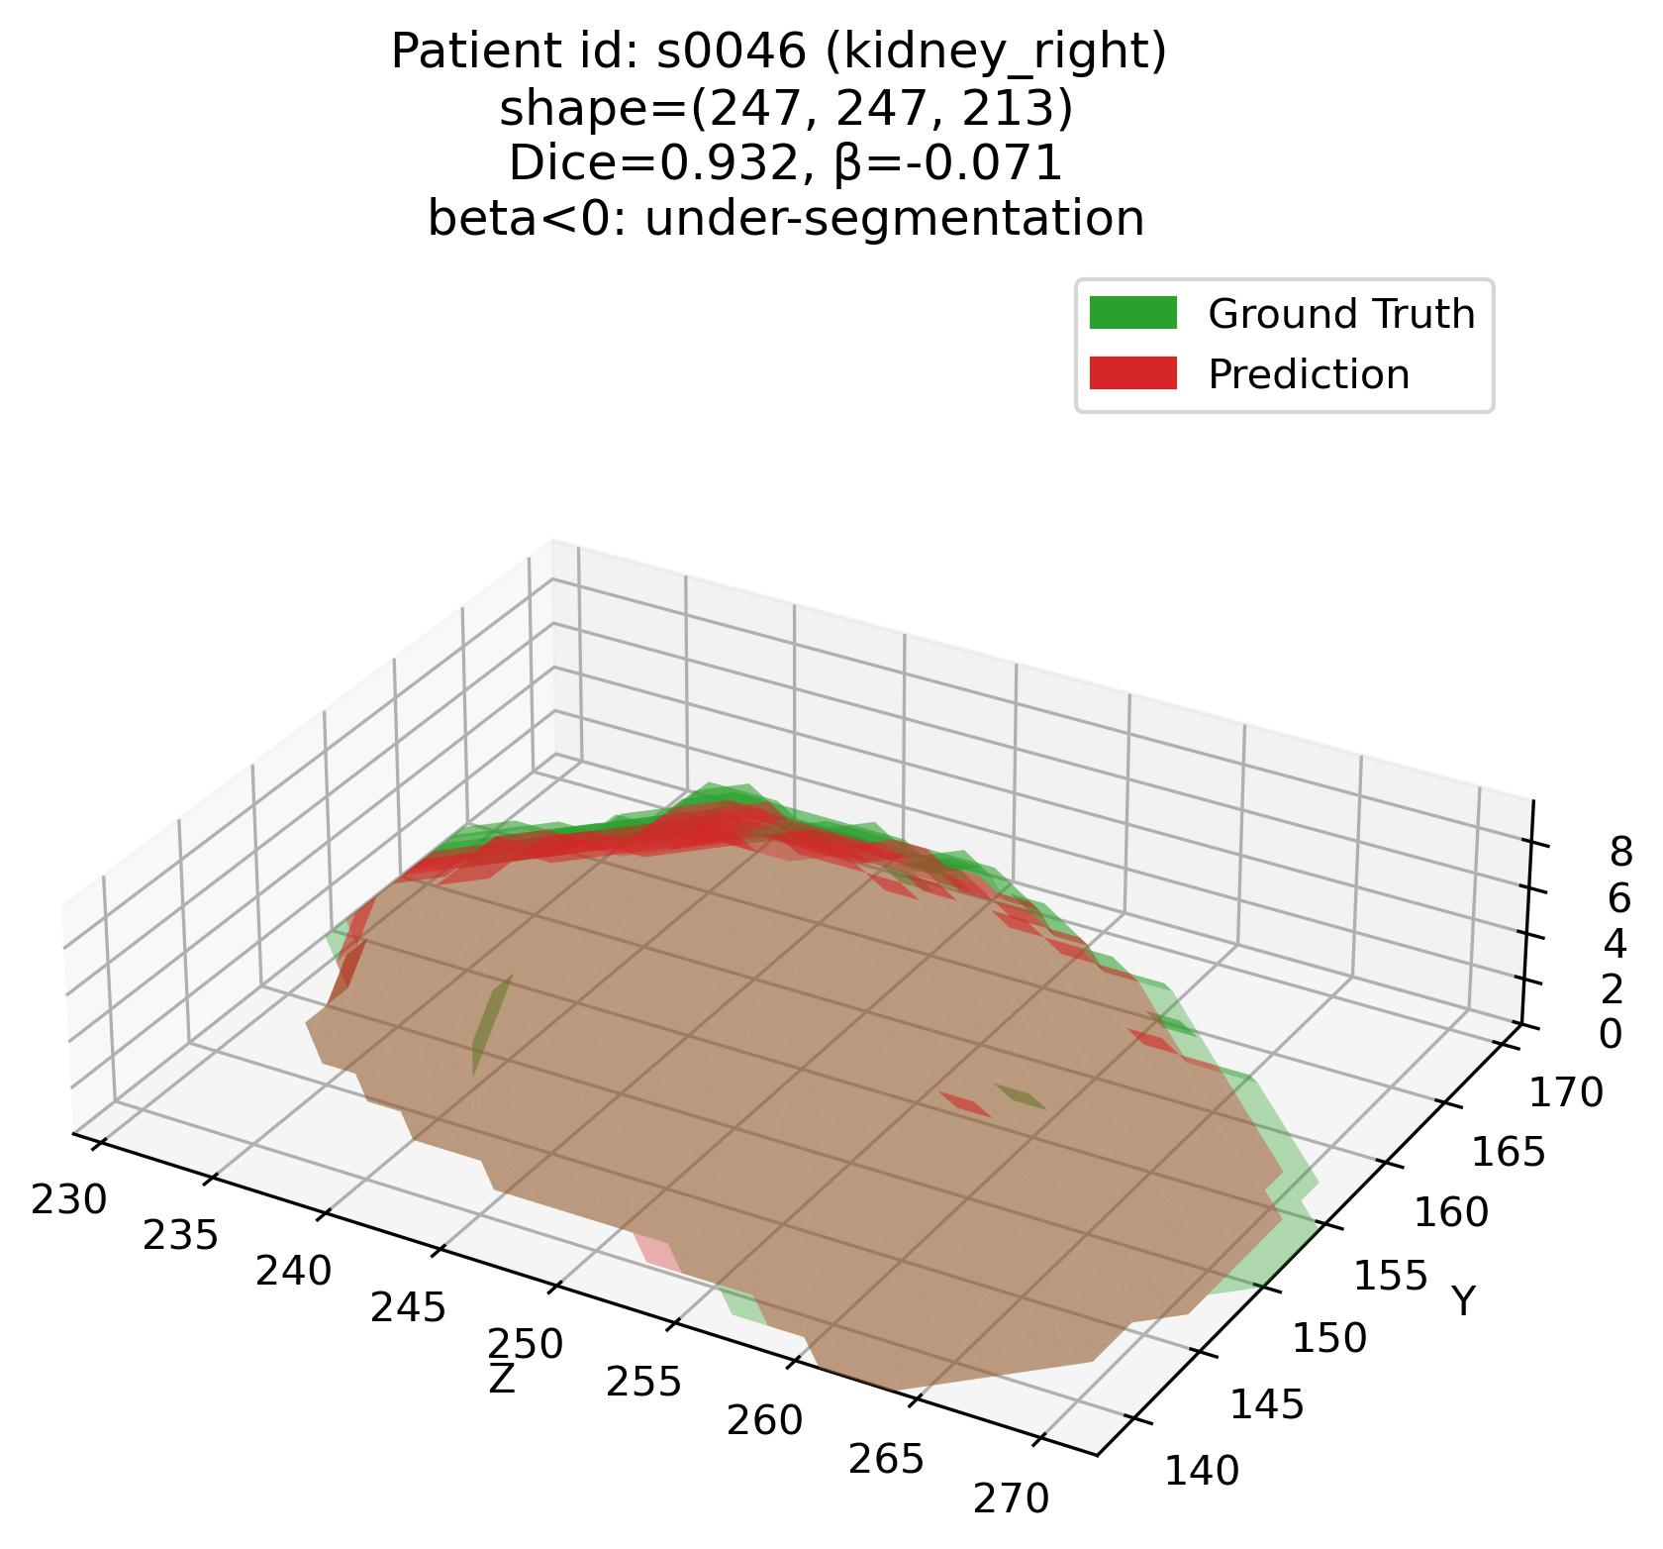
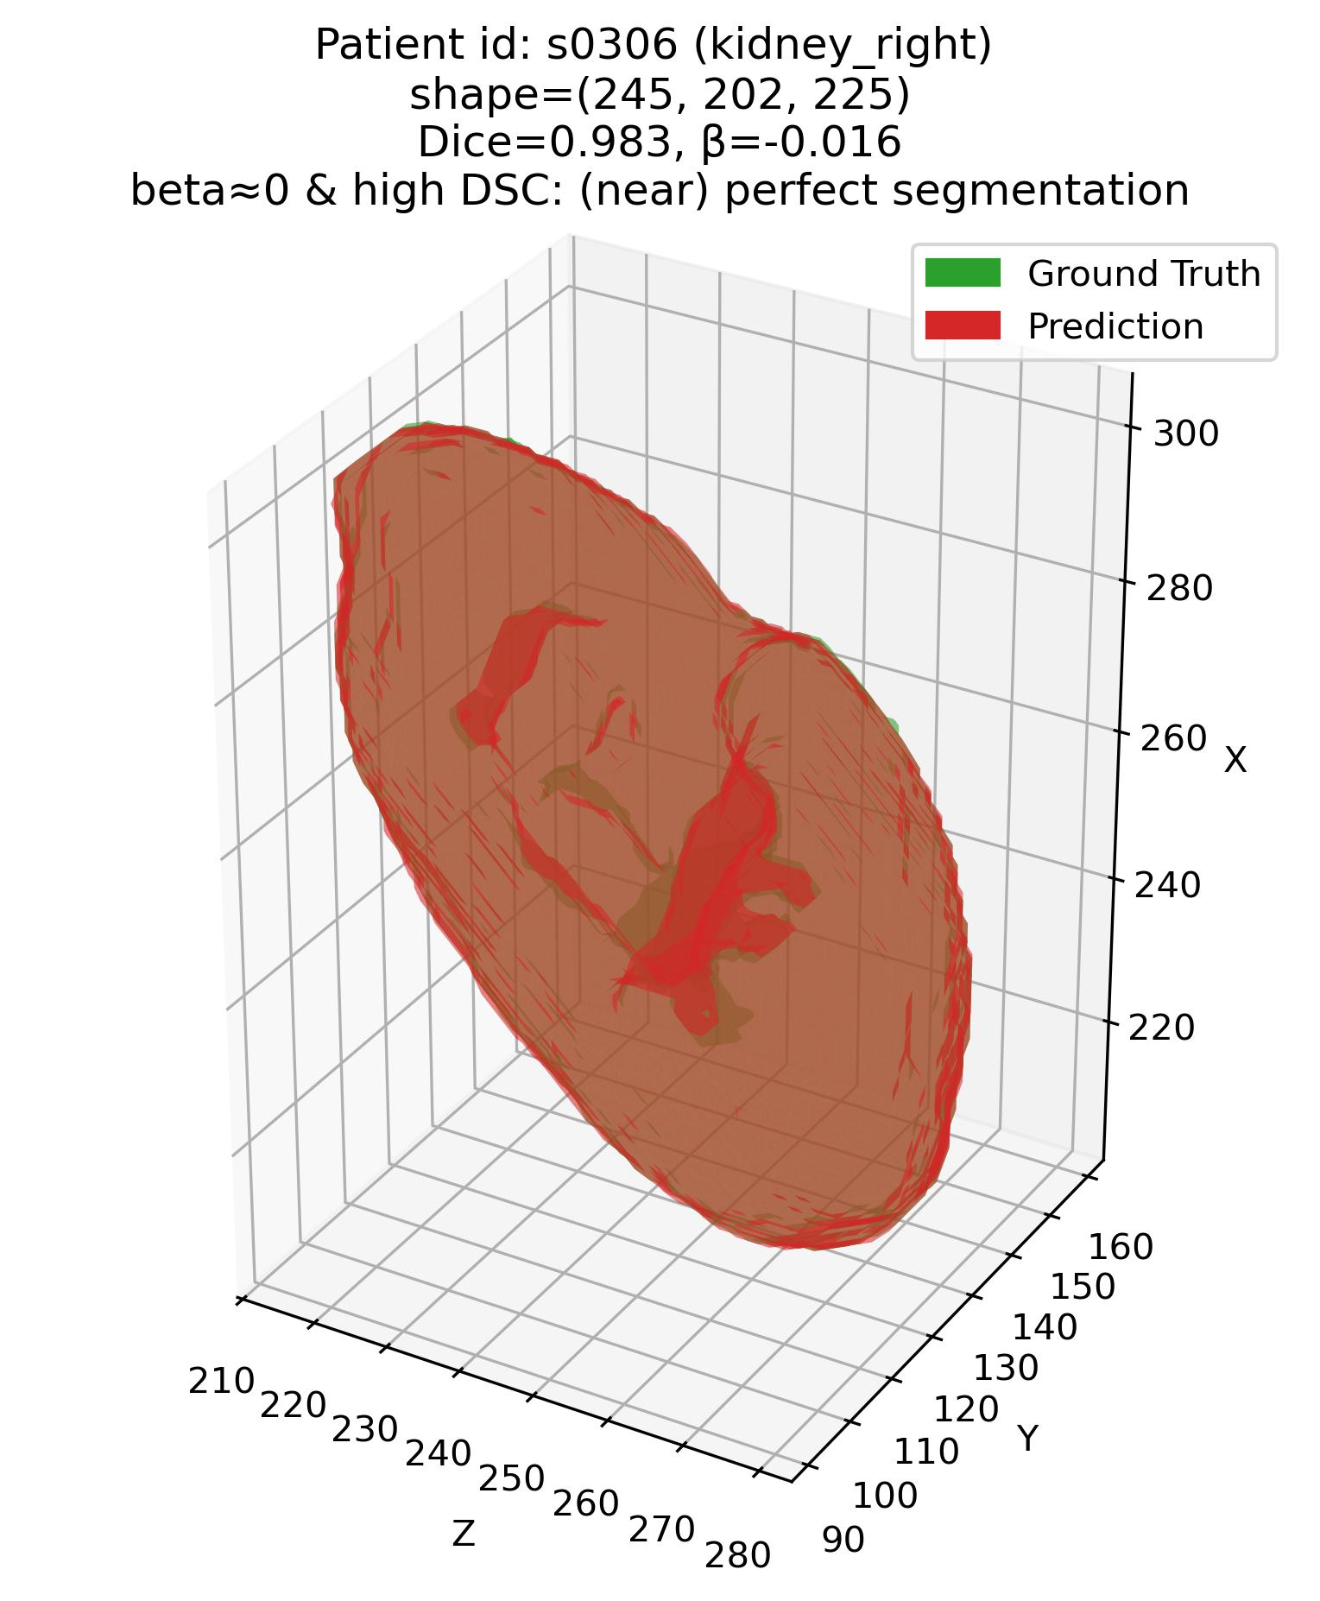
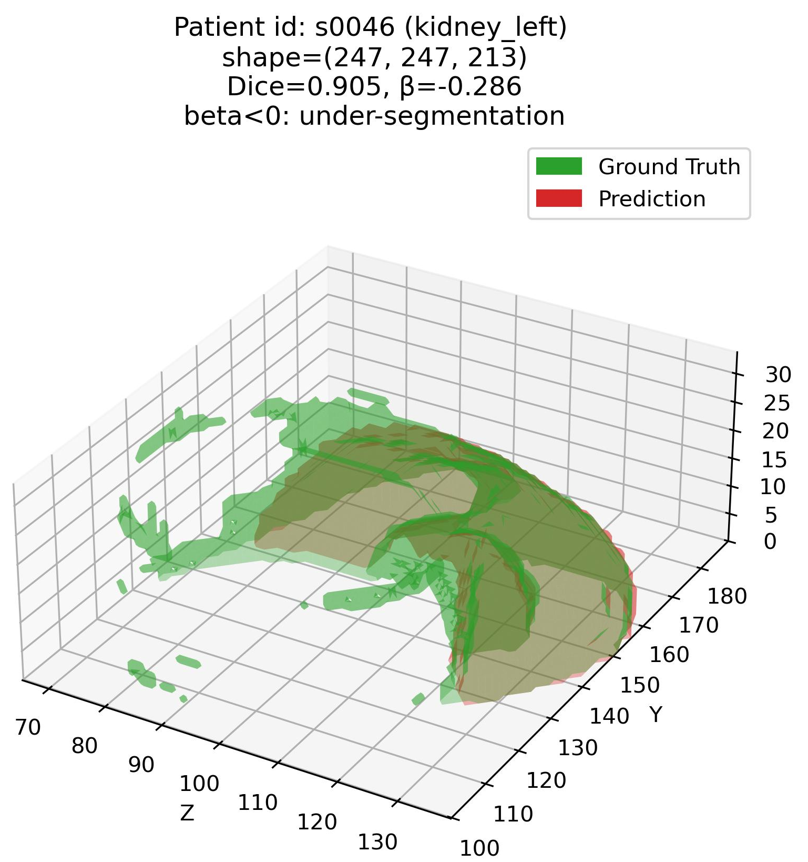
Error characterization protocol
The analysis framework – Q1
Q1: Some examples – 3. Kidneys
Patient# s0306 (Kidneys)
Patient# s0046 (Kidneys)

Slide 9
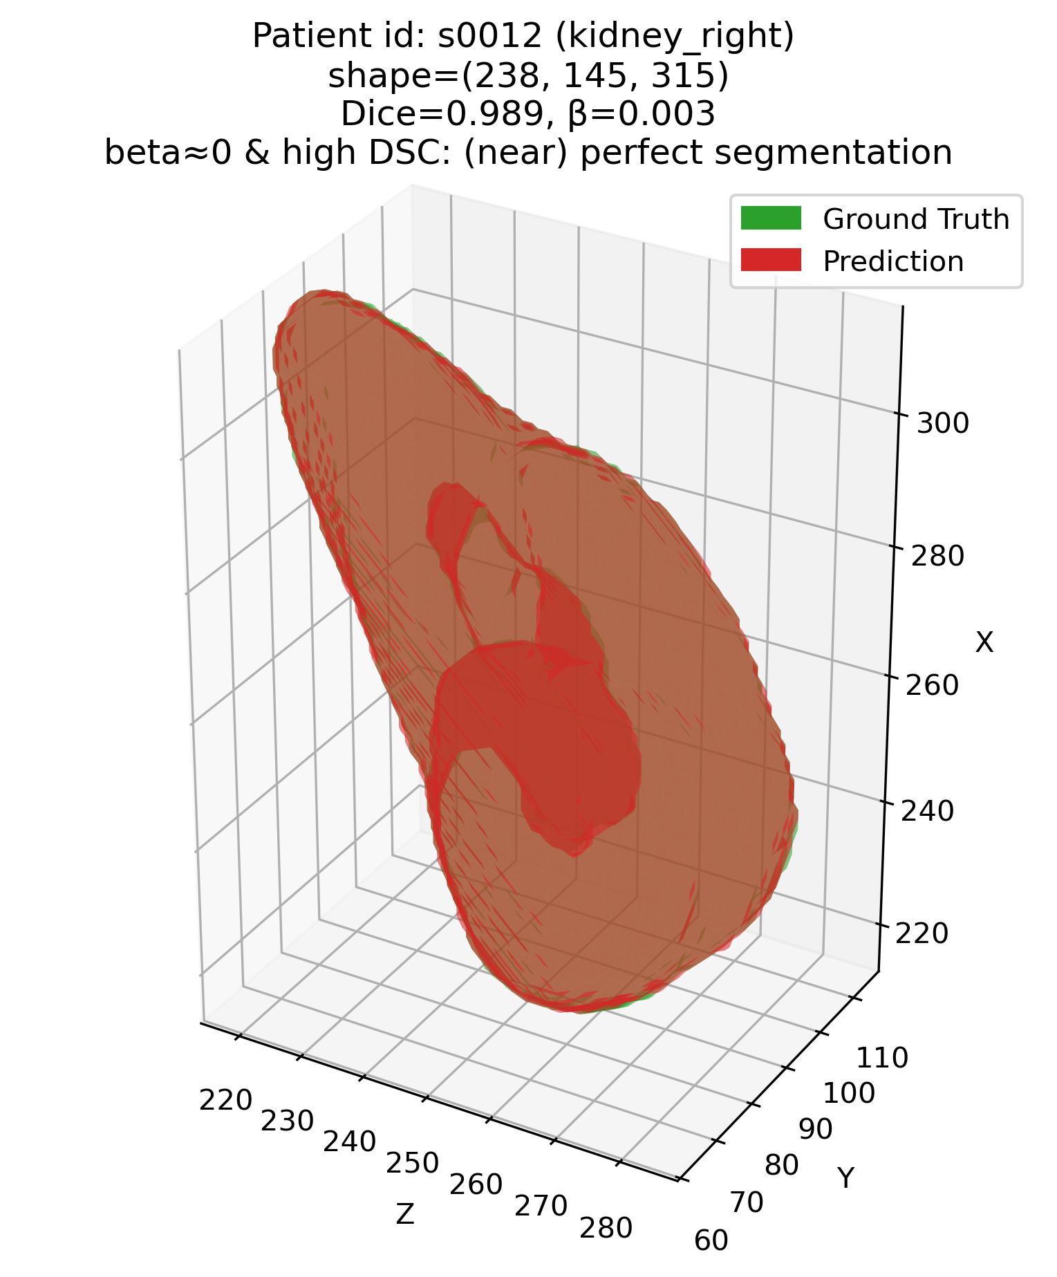
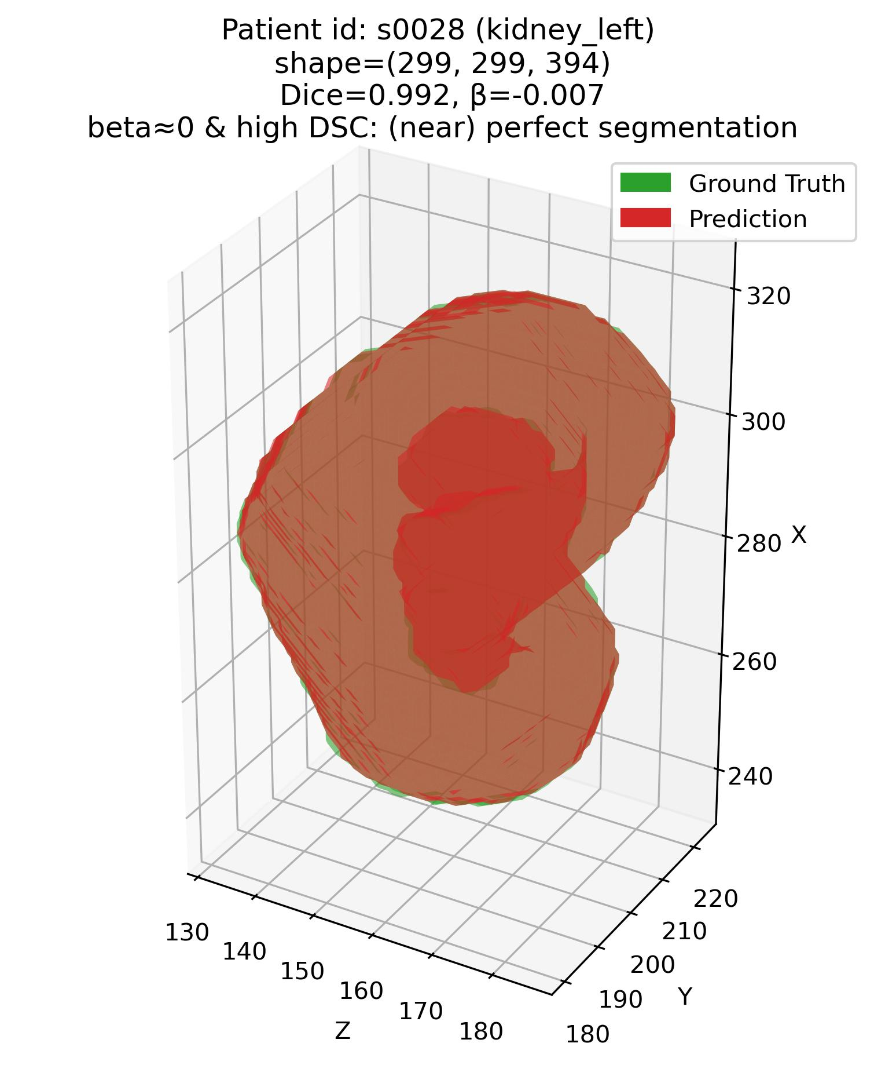
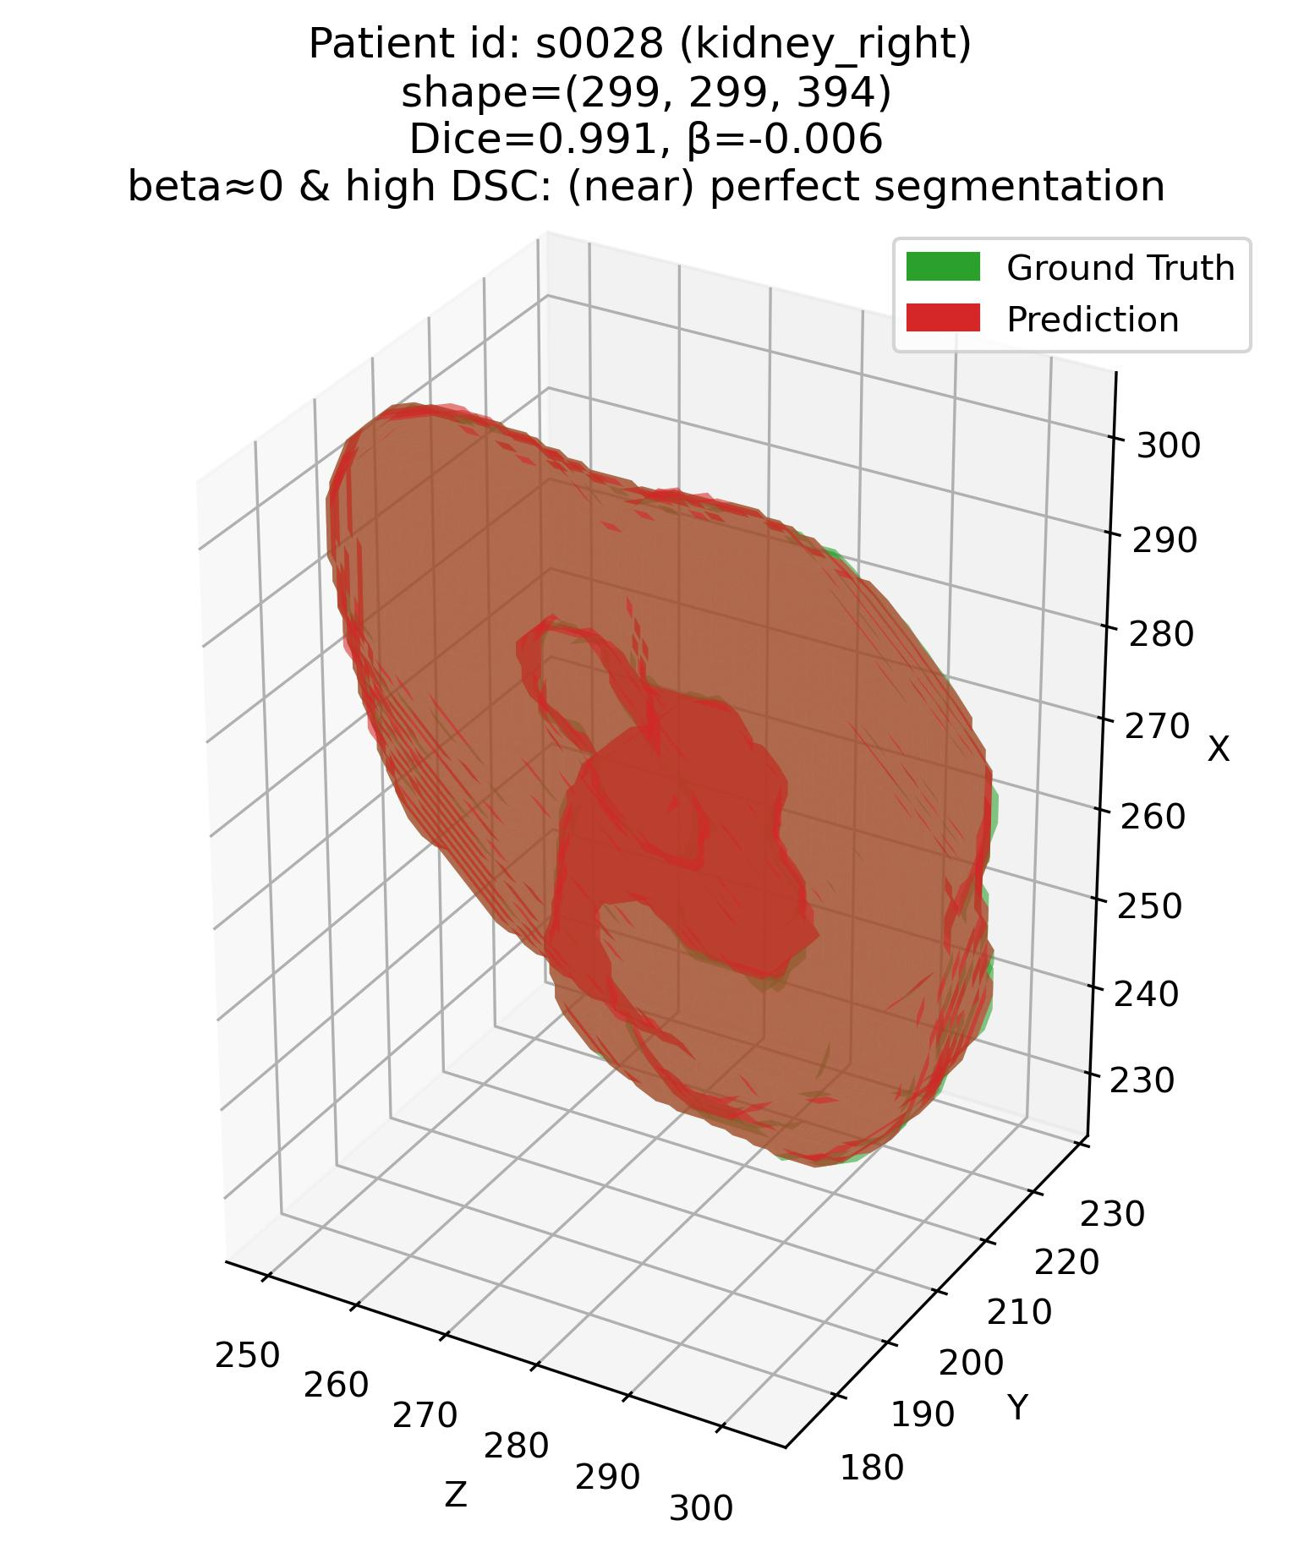
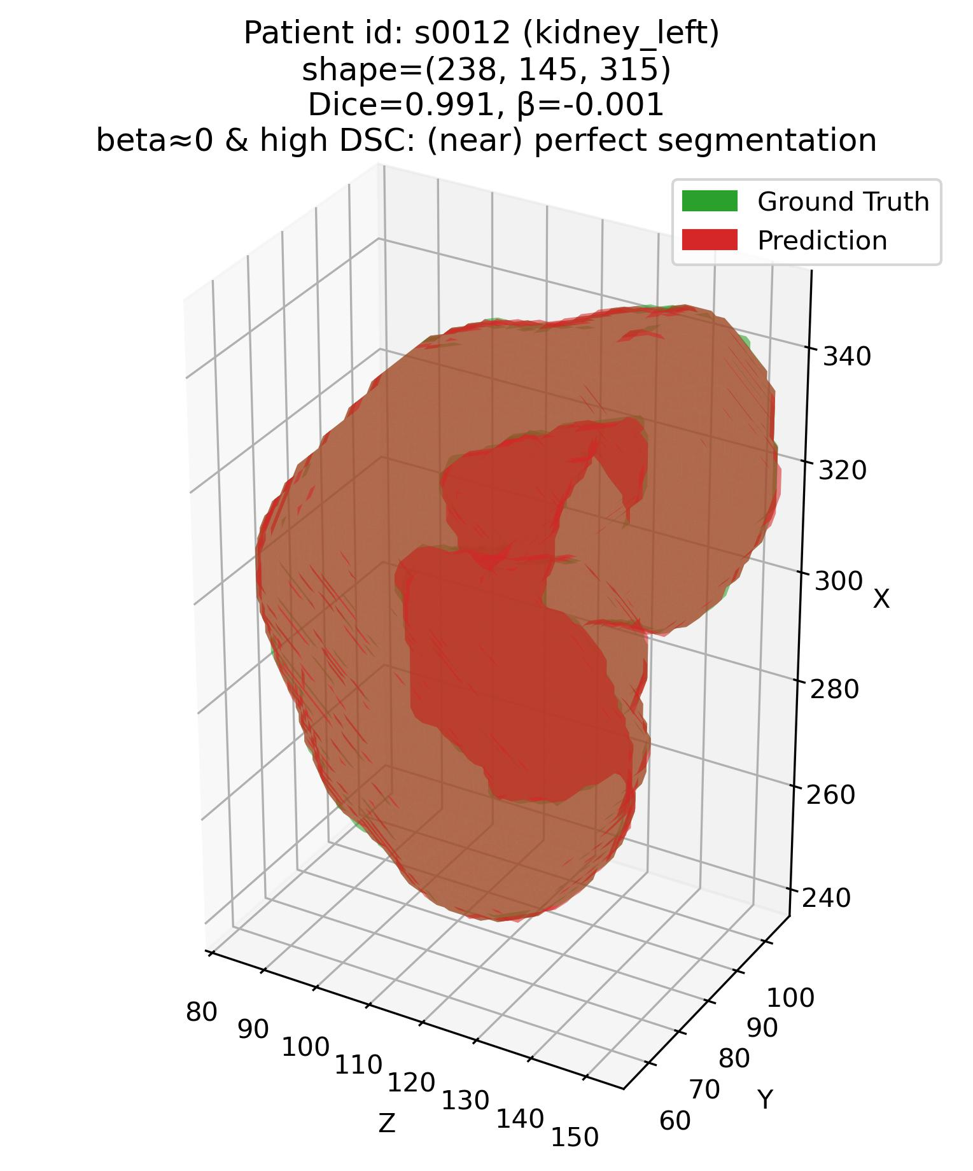
Error characterization protocol
The analysis framework – Q1
Q1: Some examples – 3. Kidneys
Patient# s0012 (Kidneys)
Patient# s0028 (Kidneys)

Slide 10
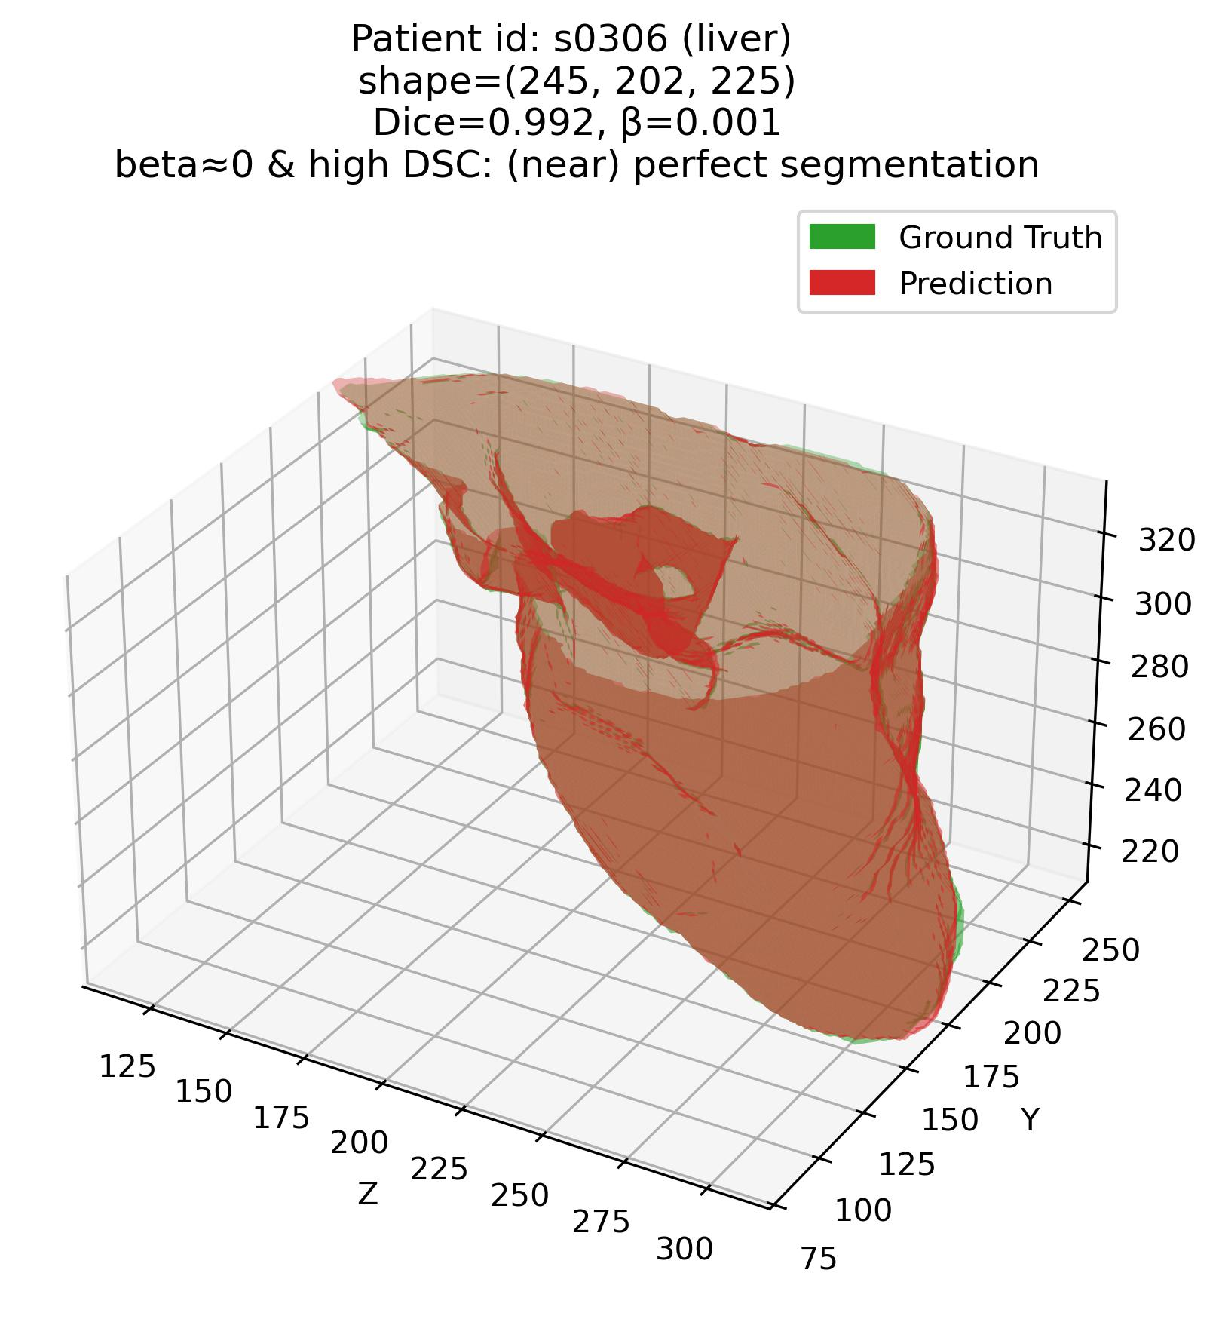
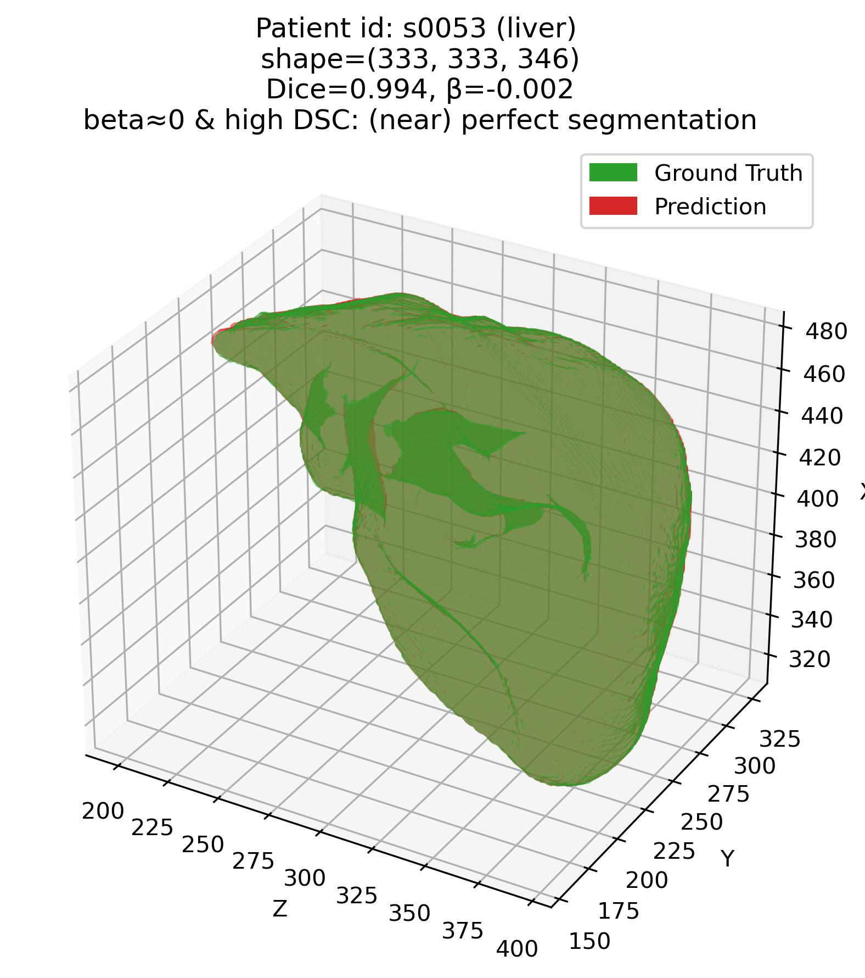
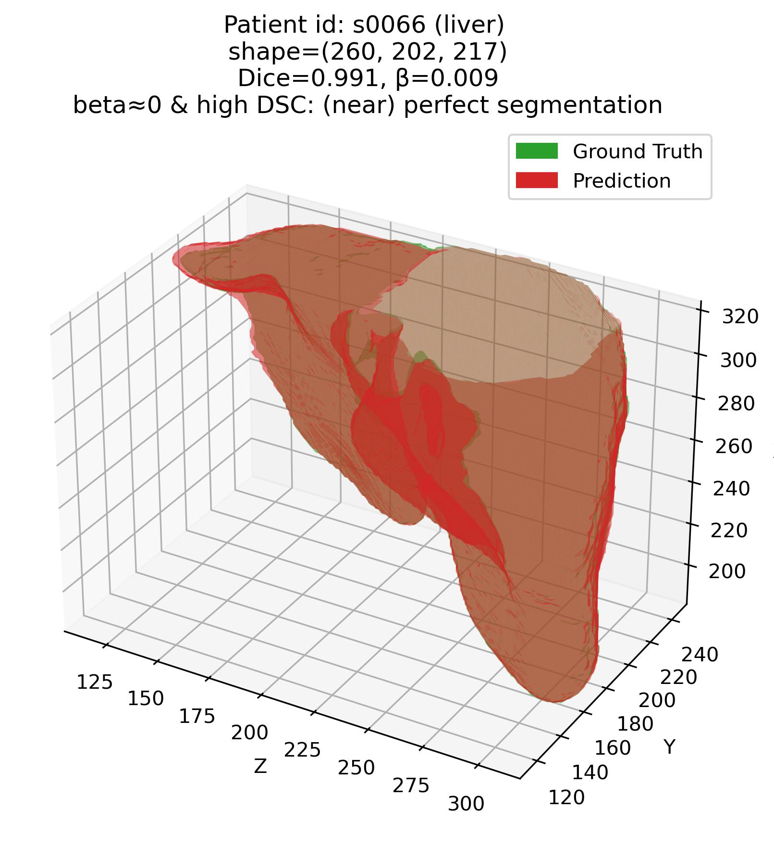
Error characterization protocol
The analysis framework – Q1
Q1: Some examples – 4. Liver

Slide 11
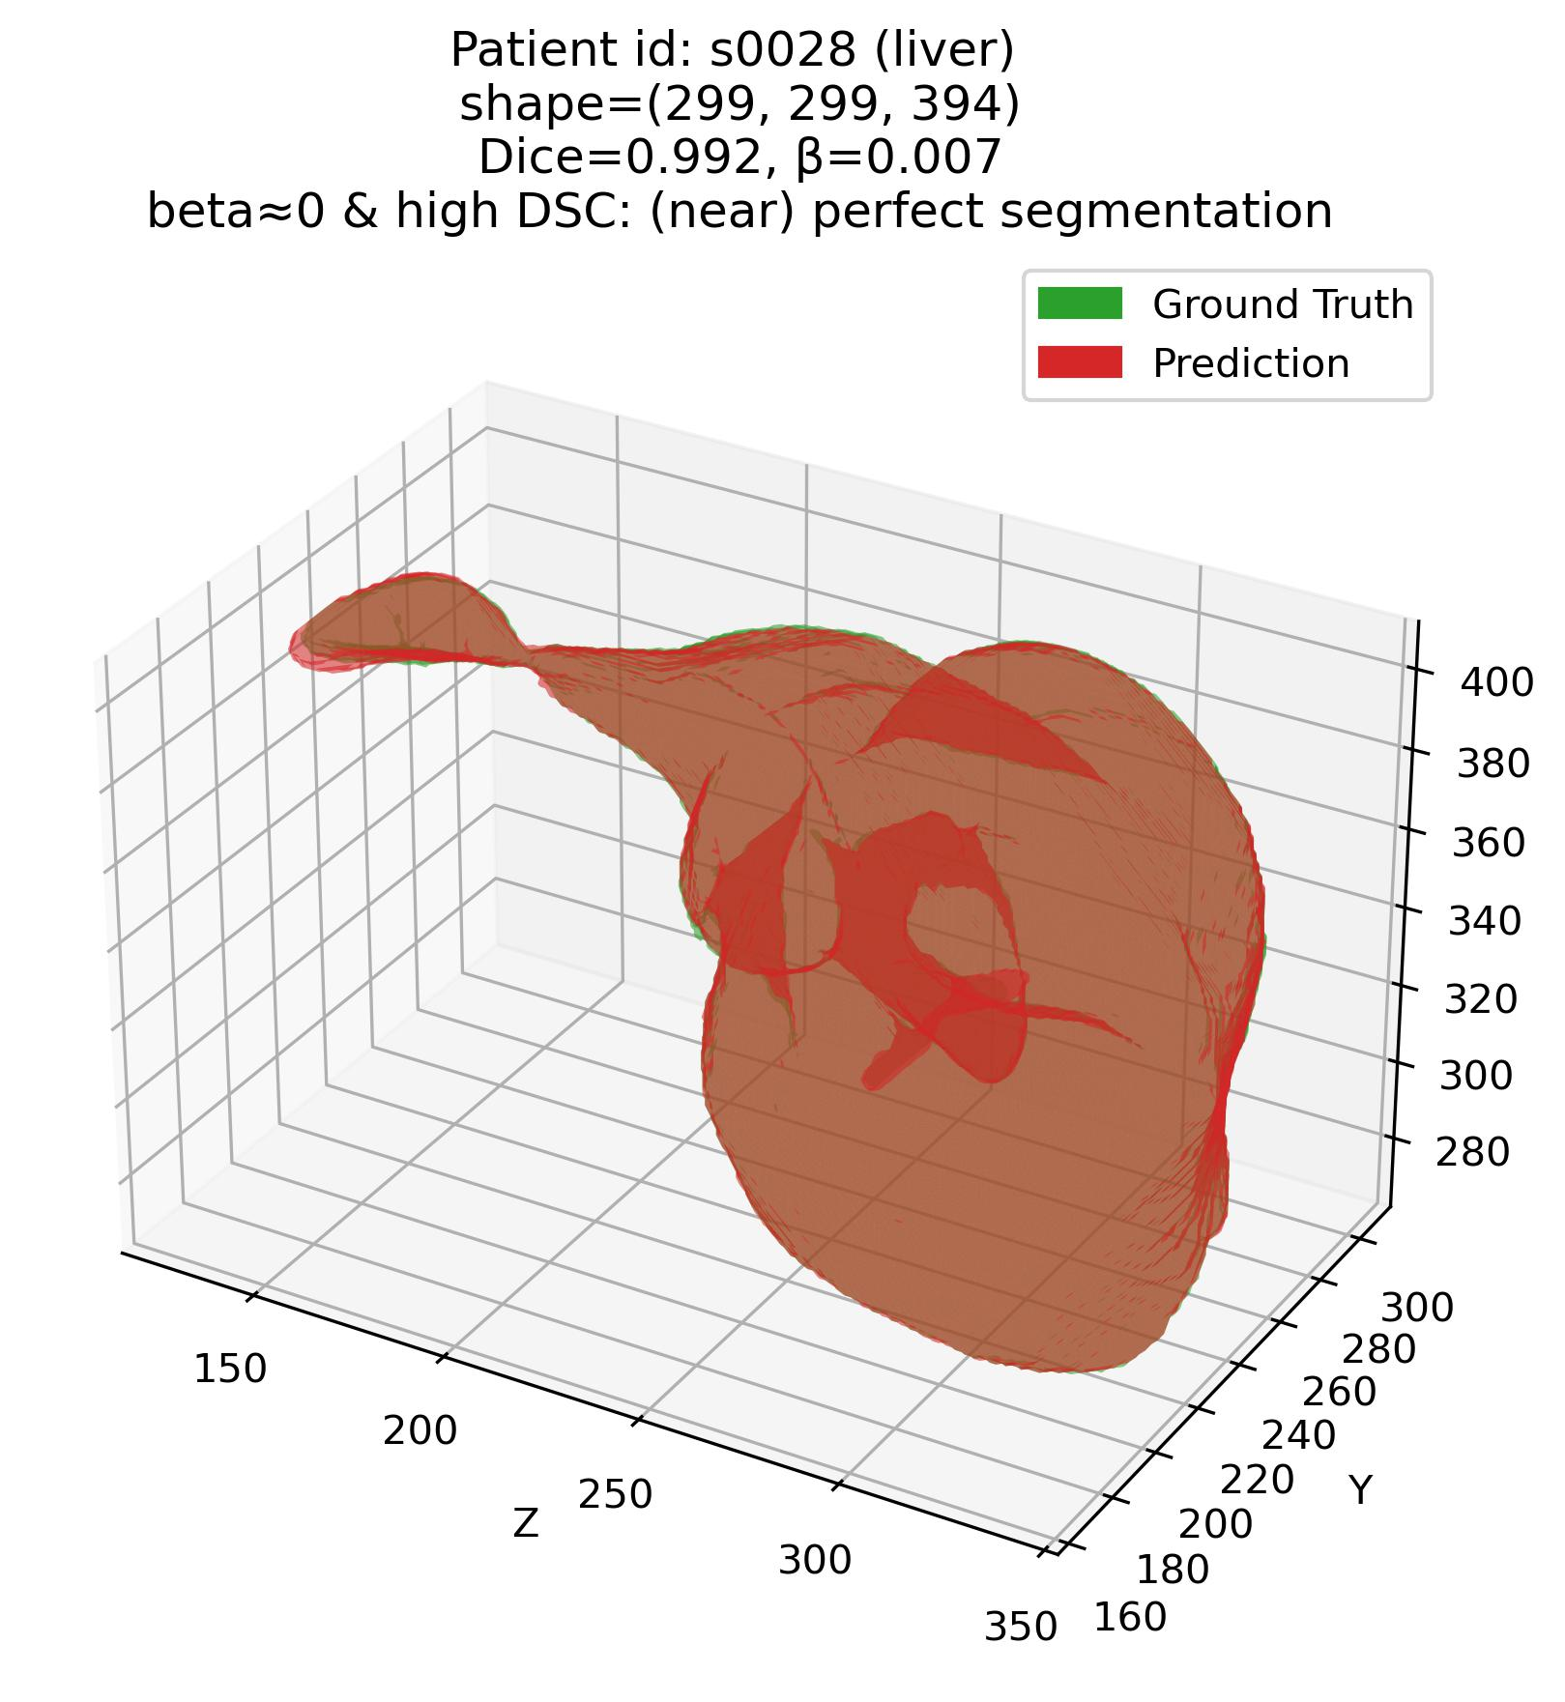
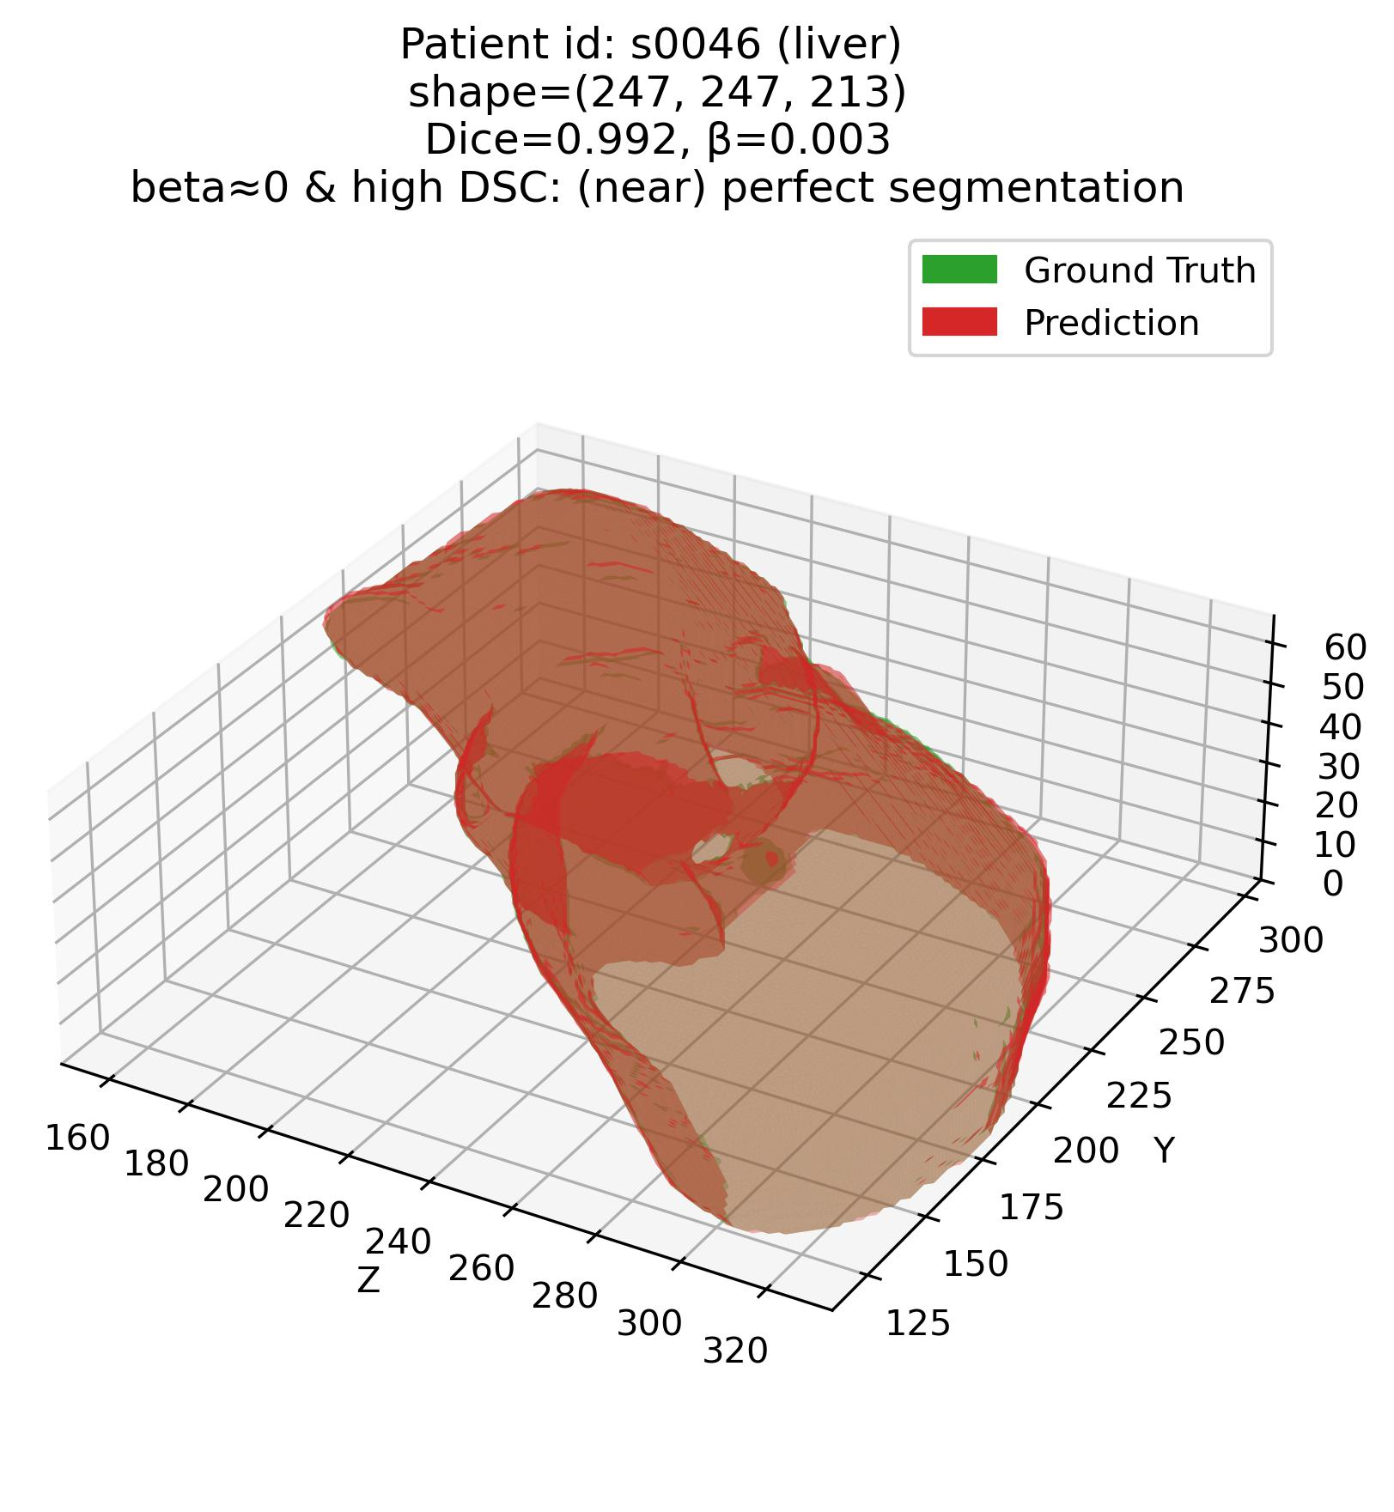
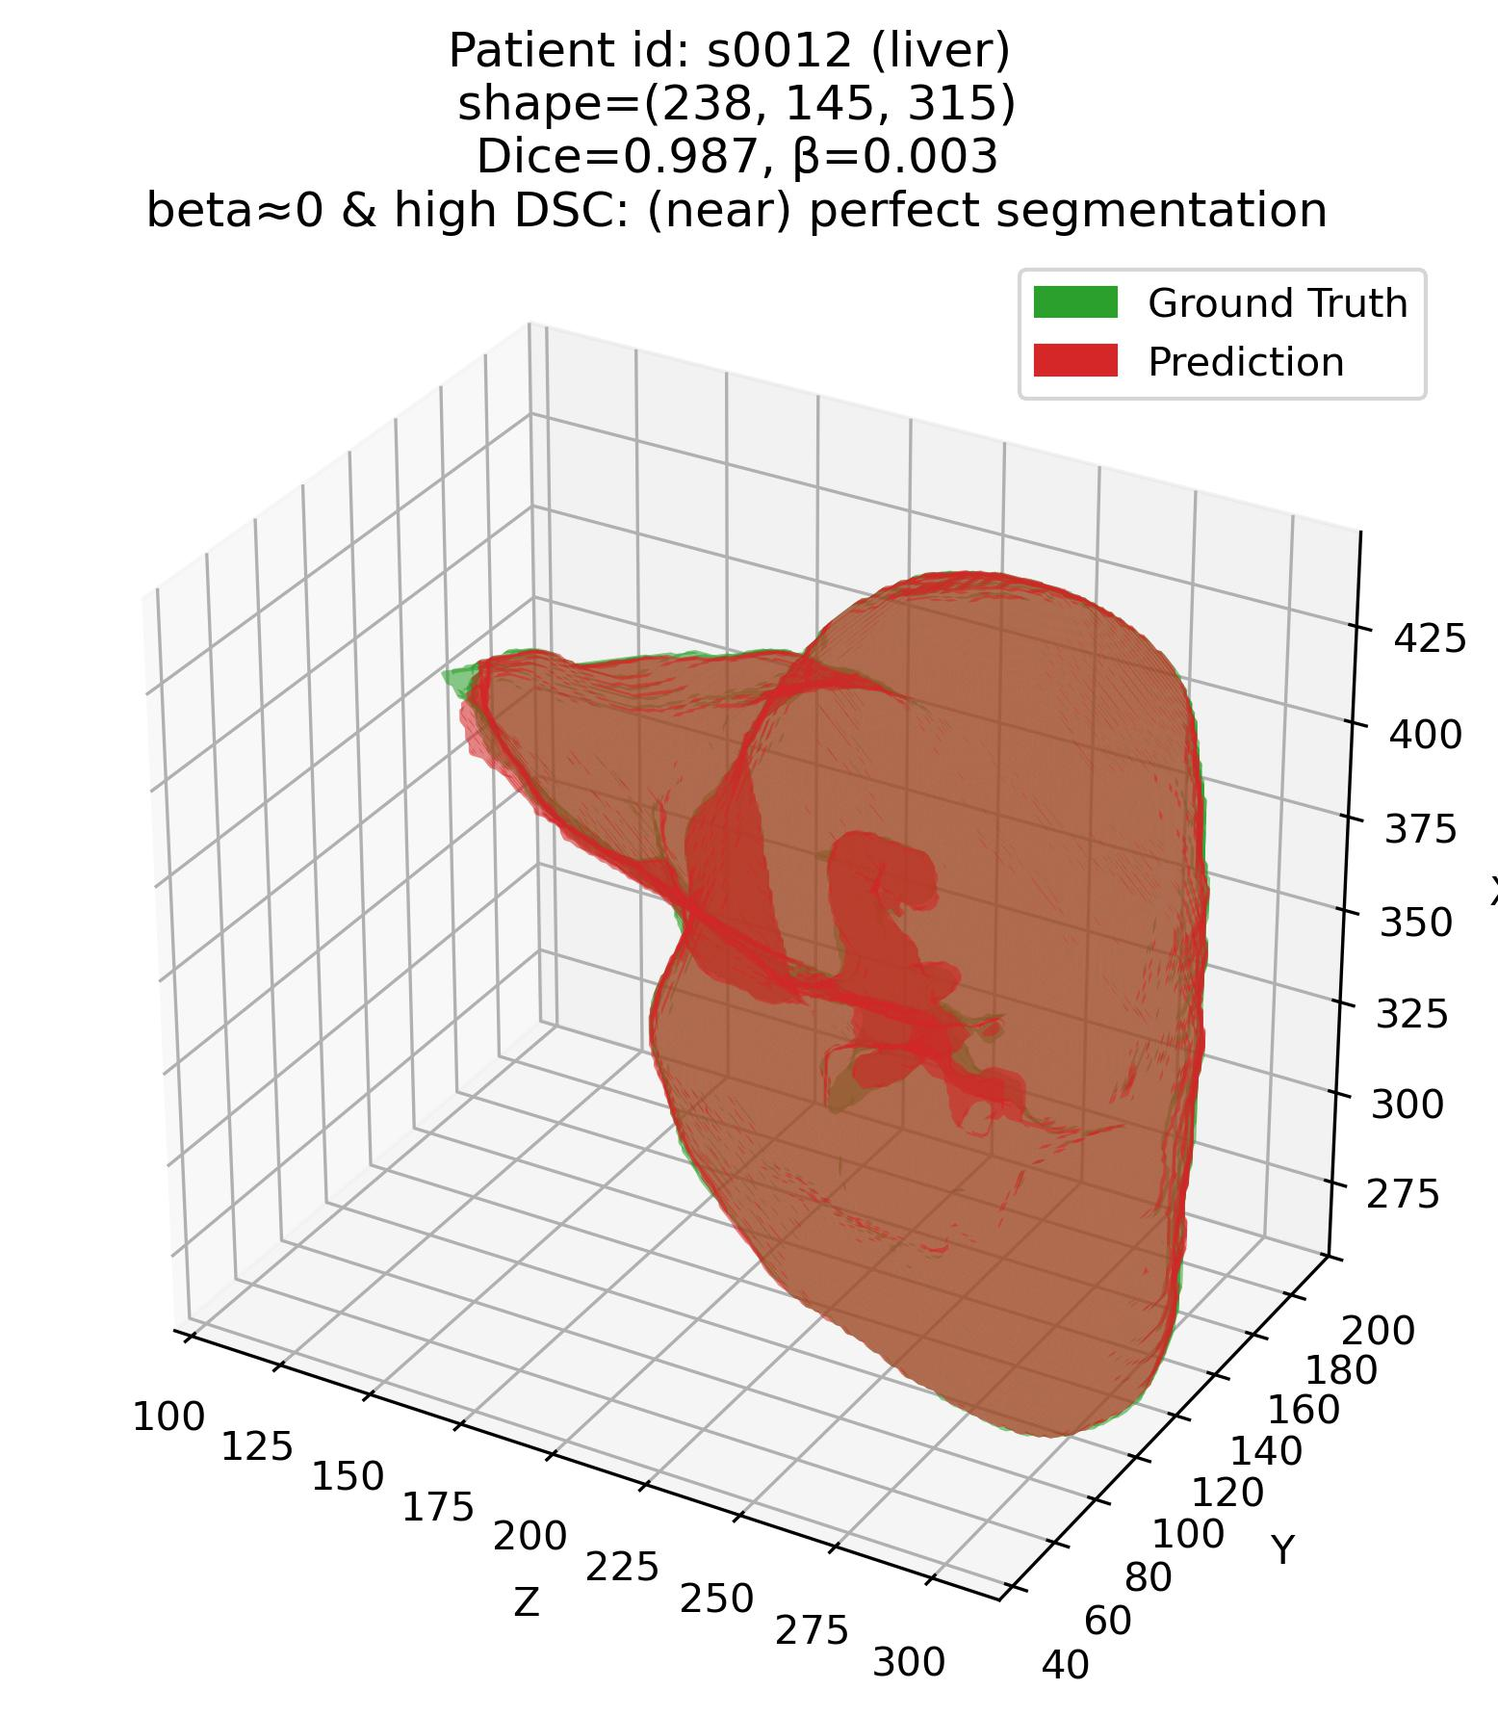
Error characterization protocol
The analysis framework – Q1
Q1: Some examples – 4. Liver

Slide 12
Thank you!

